Slide 1
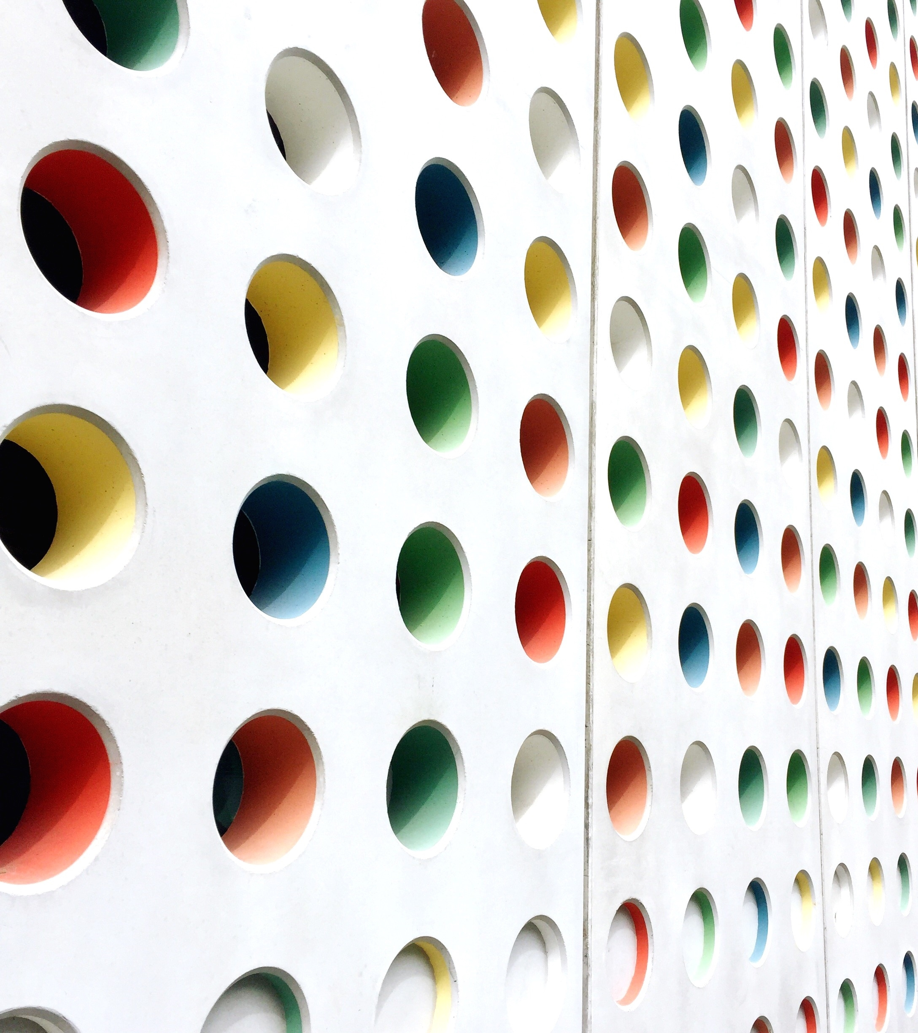
OPIOID OVERDOSE PREVENTION & RESPONSE PROGRAM

Slide 2
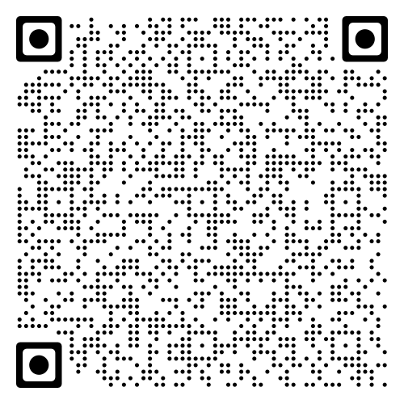
Please scan the QR code to fill out your registration form!

Slide 3
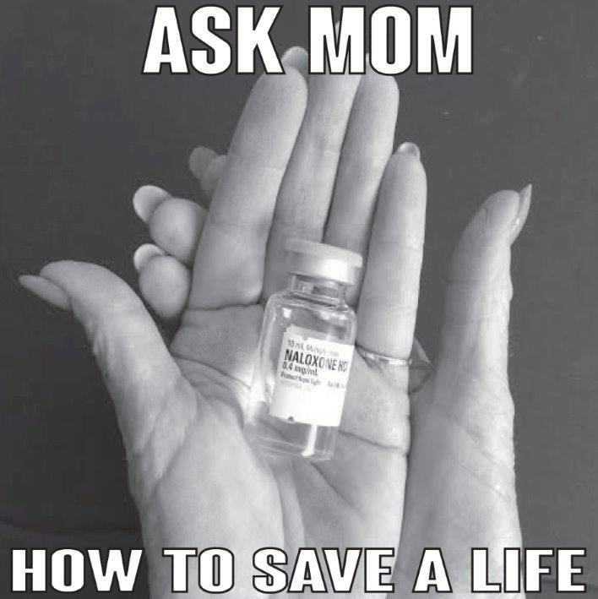
A New PATH (Parents for Addiction Treatment & Healing) is a non-profit advocacy organization of parents, concerned citizens, individuals in recovery, healthcare professionals, and community leaders. Our mission is to reduce the stigma associated with addictive illness through education and compassionate support and to advocate for therapeutic rather than punitive drug policies.
A New PATH, founded in 1999, strives to ensure access to quality cost-effective addiction treatment services, lessen harms associated with addictive illness, reduce recidivism, and save lives.
The Ask Mom How to Save a Life project is a part of A New PATH’s national Moms United to End the War on Drugs campaign
A New PATH testified in California to help pass the Naloxone Access Bill to allow organizations like us to provide Naloxone Distribution under a standing order from a licensed physician.
A New PATH provides free group and individual trainings and Naloxone in San Diego County.

Slide 4
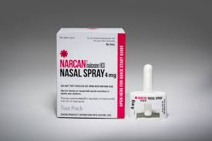
SINCE 2014
A NEW PATH HAS TRAINED OVER
14,000 INDIVIDUALS HOW TO
RECOGNIZE AND RESPOND TO AN
OPIOID RELATED OVERDOSE AND HOW TO ADMINISTER NARCAN
IN THE PAST 7 YEARS, OUR PROGRAM HAS A REPORTED 3,100 OPIOID OVERDOSE REVERSALS FROM THE USE OF NARCAN DURING AN
ACCIDENTAL OVERDOSE

Slide 5
Training Program Details
About Opioids
About Narcan/Naloxone
How to recognize and respond to an opioid related overdose
How to contact emergency medical services
How to use Narcan/Naloxone
About the Good Samaritan Law
Refill Procedure

Slide 6
Opioid Related Deaths in San Diego
152 fentanyl related deaths in san diego county in 2019
457 fentanyl related deaths in san diego county in 2020
FROM APRIL 2020 TO APRIL 2021, OVER 100,000 INDIVIDUALS DIED OF AN OPIOID OD IN THE U.S.

Slide 7
What are Opioids?
The group of drugs called opioids includes:
Heroin
Morphine
Codeine
Oxycodone
Other prescription pain killers ie.) Vicodin or Percocet
Fentanyl (synthetic)
Carfentanyl (synthetic)
(Not benzodiazepines)

Slide 8
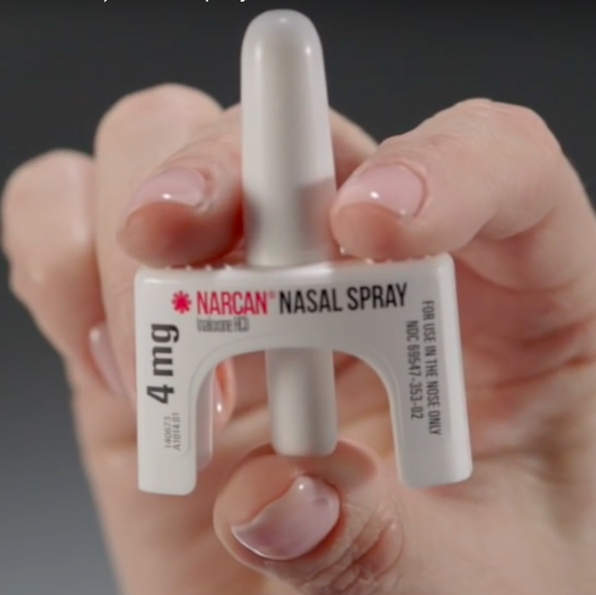
What is Naloxone?
Naloxone is a prescription medicine that reverses an opioid overdose. It cannot be used to get high and is not addictive. Naloxone is safe and effective; paramedics and doctors have used it for decades.
Naloxone is also called by brand name Narcan®
Naloxone is an opioid antagonist

Slide 9
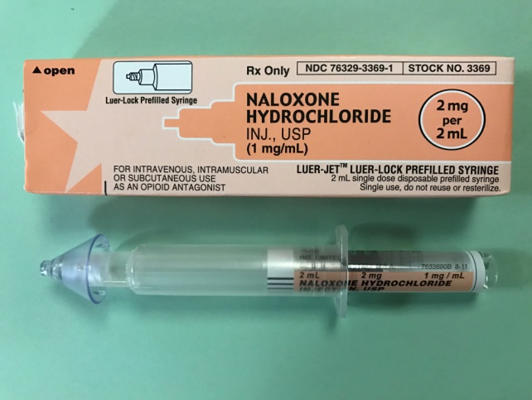
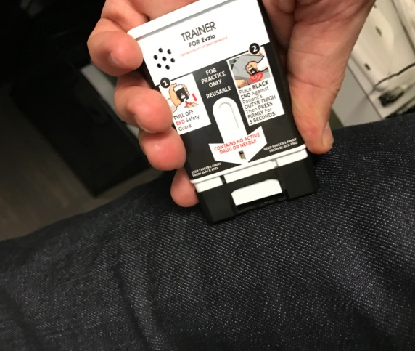
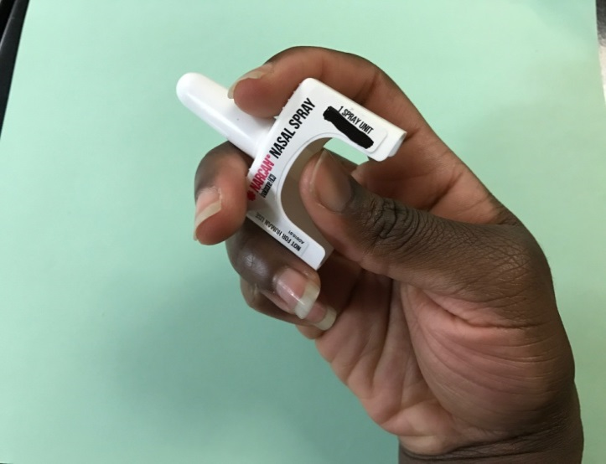
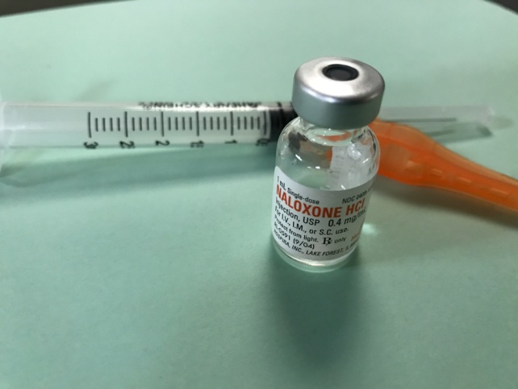
Naloxone Formulations

Slide 10
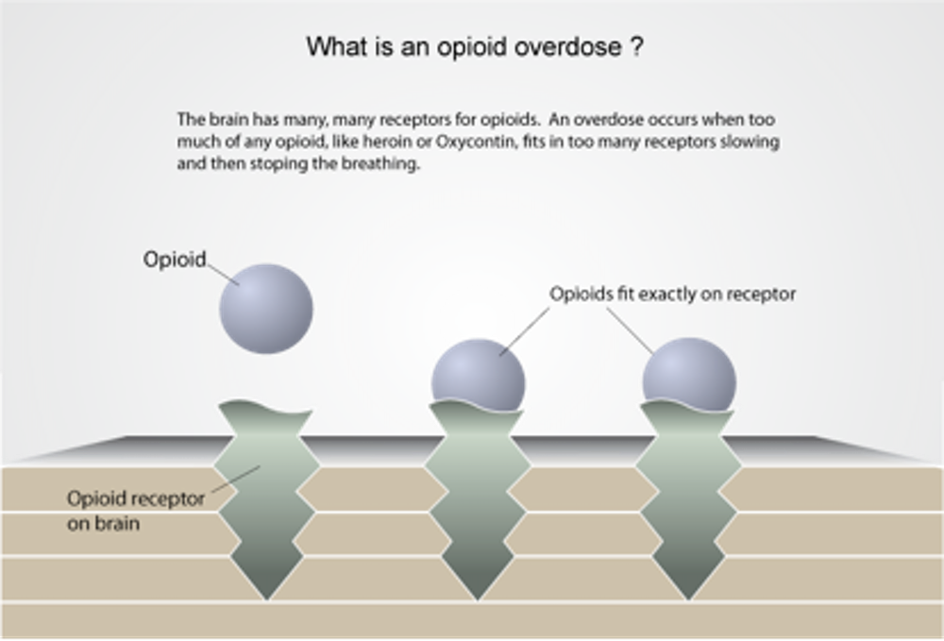
What is an Opioid Overdose?
The brain has many receptors for opioids. Too much of an opioid fitting in too many receptors slow and stop breathing.

Slide 11
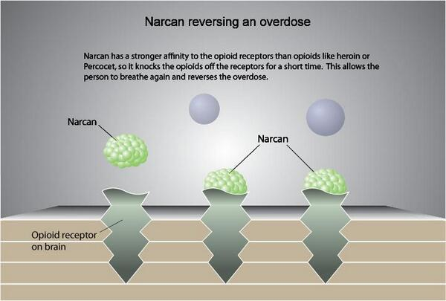
Naloxone reversing an OD

Slide 12
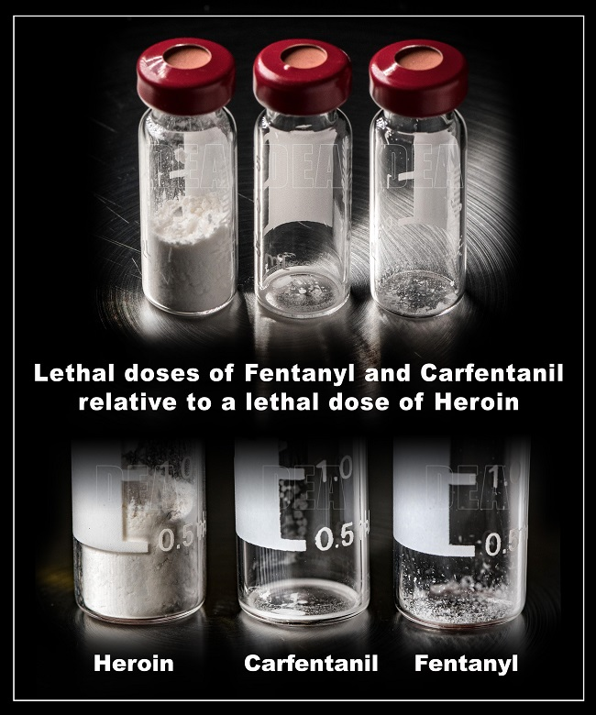
Opioid ODs (continued)
ODs can be instantaneous or over a longer period of time
ODs happen as a process – someone slowly stops breathing
They usually happen 1-3 hours after the drug was used if a person is actively using
With Fentanyl or Carfentanil it happens instantaneously
With new users it can be instantaneously
Someone “found dead with a needle in their arm” is a rare event that is sensationalized

Slide 13
Fentanyl Safety Tips
If you touch fentanyl, it can be removed from skin with soap and water
Alcohol-based products, such as hand sanitizer or wipes, may increase fentanyl absorption
Wash your hands soon, but not necessarily immediately
Powdered fentanyl does not penetrate the skin very easily but avoid touching lips or eyes
There is no need for special gear or double gloving - one pair of nitrile gloves is enough
Carry naloxone and be familiar with it for both the patient and your partners.
Notes:
TC: What should first responders do if they are exposed to fentanyl through air?
MB: This would be an exceedingly rare occurrence- there would have to be a deliberate attempt to do so such as someone blowing powder in their face or an encounter in a drug lab where there has been a great disturbance like a raid or explosion. If the situation is a cloud of dust/material, (i.e. drug lab raid with explosions/shooting/powder everywhere) they should not go into it. The recommendations in that situation are very different and beyond what we can discuss here. For situations where there are small amounts of airborne powder (i.e. a usual user level amount of material in a small container), increase precautions including gloves, long sleeves, and pants, and a particulate [N95] mask may be considered, BUT are not always required. Again, the dose makes the toxin and simply seeing an open baggie is not a reason to increase protection beyond gloves.

Slide 14
Risks for Overdose
Mixing Drugs
Benzos are common in opioid ODs
Uppers and downers do not cancel each other out.
Mixing opioids and stimulants actually increases risk for overdose.
Tolerance changes (e.g., illness or leaving jail or detox)
Using alone
Change in dealer, product (type/purity), method of taking (e.g., sniffing to injection)
Thinking you “know everything”

Slide 15
Signs/Symptoms of an OD?
REALLY HIGH | OVERDOSE
Muscles become relaxed | Deep snoring or gurgling (death rattle)
Speech is slowed/slurred | Very infrequent or no breathing
Sleepy looking | Pale, clammy skin
Nodding | Heavy nod
Responsive to stimulation like yelling, sternum rub. | Not responsive to stimulation
 | Slow heart beat/pulse
Body very limp
Face very pale
Pulse (heartbeat) is slow, erratic, or not there at all
Throwing up
Passing out
Choking sounds or a gurgling/snoring noise
Breathing is very slow, irregular, or has stopped
Awake, but unable to respond
Blue or ashy skin tinge, usually lips and fingertips show first

Slide 16
Identifying an Overdose
You’ve seen enough to be worried; now you check on them, by:
Tapping their foot
Asking: Are you alright? You ok?
Saying something alarming
If no response; try a STERNUM RUB
Rake your knuckles across a person’s breastbone – HARD!
This is enough pain to wake them up, IF any pain is going to wake them up.
If still no response, Call 9-1-1 and proceed with OD response.

Slide 17
Responding to an Overdose
Call 9-1-1
Administer first dose of Naloxone (Narcan)
If no response, administer second dose of naloxone
Rescue Breathe if your supply of Naloxone is depleted
Stay with the person until emergency medical services arrives

Slide 18
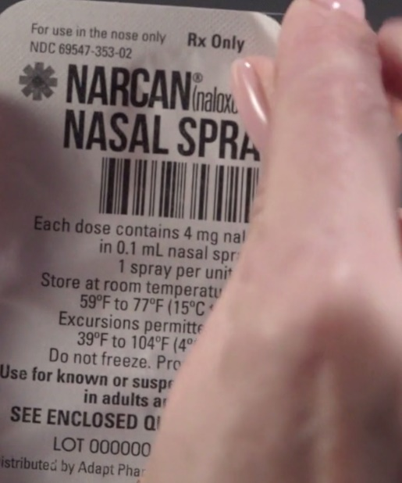
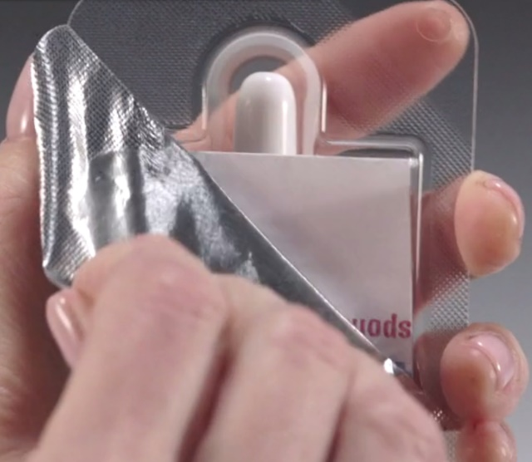
Deploying the nasal spray kit

Slide 19
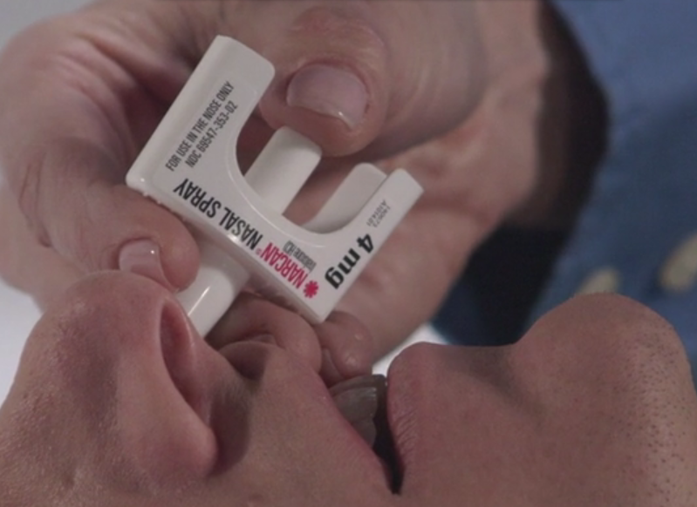
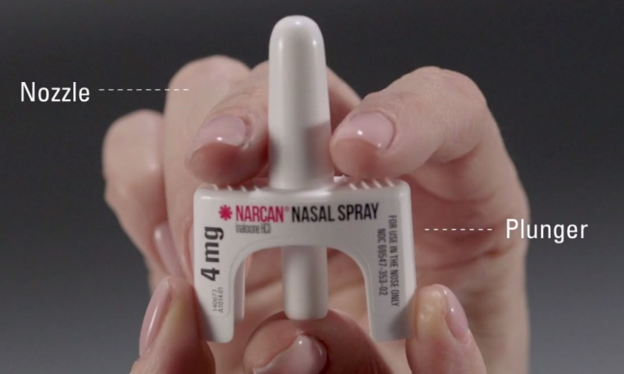
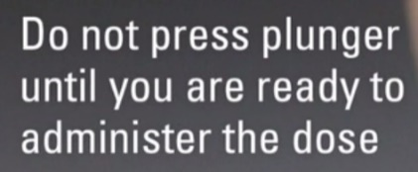
Deploying the nasal spray kit

Slide 20
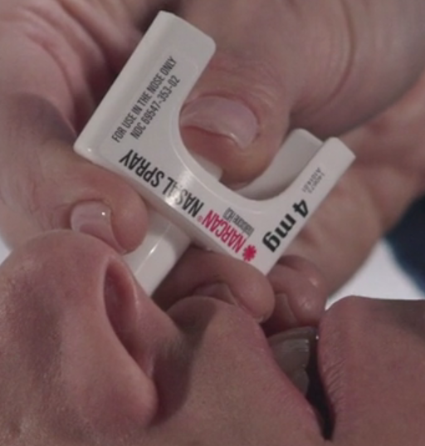
Deploying the nasal spray kit

Slide 21
Barriers to calling 911:
Fear of legal risk (outstanding warrants, DSS involvement, loss of public housing)
Fear of judgment from family/community
Personal embarrassment/shame
Other punitive measures (students loose federal financial aid)

Slide 22
California 911 Good Samaritan Law
Under California law (H&S 11376.5), if you witness an overdose and call 911 for help, you are protected:
“It shall not be a crime for any person… who, in good faith, seeks medical assistance for the person experiencing a drug-related overdose, to be under the influence of, or to possess for personal use, a controlled substance, controlled substance analog, or drug paraphernalia…”
This person experiencing an overdose is also protected for these offenses.
Notes:
Section 11376.5 to the Health and Safety Code

Slide 23
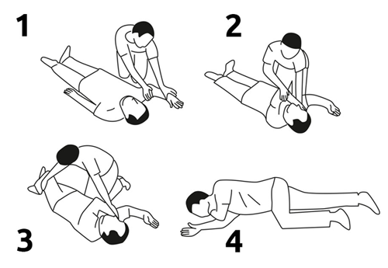
Responding: Recovery Position
If you have to leave, put person in recovery position:
On their side
Place bottom arm under the head
Place top leg crossed over the body
Knee should be bent for stability

Slide 24
Responding: When they come to
Tell them what’s happening:
Explain they overdosed; you administered naloxone.
They may be in withdrawal from the naloxone.
Stay with them & monitor their breathing.
Inform them that:
Naloxone wears off in 30-90 minutes; opioid is still in the body.
Overdose can come back once naloxone wears off or if they use again too soon.
If paramedics not coming, person should visit a doctor as soon as possible; could have fluid/vomit in lungs

Slide 25
What not to do in case of an overdose
Don’t leave the person alone—they could stop breathing
Don’t put them in a bath—they could drown
Don’t induce vomiting—they could choke
Don’t give them something to drink—they could throw up
Don’t put ice down their pants—it will cool down their core body temperature and slow body function even more.
Don’t try to stimulate them in a way that could cause harm—slapping too hard, kicking in the testicles, burning the bottom of the feet—it won’t do more than a sternum rub (causing pain) and can cause long-term damage
Don’t inject them with anything but naloxone (saltwater, cocaine, milk)—it won’t do any more than a sternum rub (causing pain) and can waste time or make things worse. For example, a salt injection could cause someone to go into cardiac arrest if they already have high sodium levels in their system.

Slide 26
Naloxone Care
Keep out of direct light and heat, efficacy goes down if you have your Narcan exposed to direct light and heat
Can be kept in a cool dry place at room temperature
Do not leave in a car if it is parked outside
Should be easily accessible

Slide 27
What happens if I use my naloxone?
If it gets used, tell your prescriber
No punishment
Get a new dose of Naloxone
Naloxone is available at the pharmacy without an outside prescription if you or your family want additional doses
It is also available at all San Diego County Health and Human Service Agencies, with other local organizations including NAMI San Diego, Harm Reduction Coalition of San Diego, Say San Diego, Mental Health Systems North Inland and Episcopal Community Services.
Notes:
Then give opportunity for patient to ask questions

Slide 28
Contact Information
A New PATH
619-990-5800
april@anewpath.org
www.anewpath.org

