Slide 1
Implementing Contingency Management for Patients with Substance Use Disorders
Experience at a Federally Qualified Health Center

Slide 2
Meet our Presenters
Courtney Summers-Day, MD
Dr. Courtney Summers-Day has served as Chief Medical Officer of Imperial Beach Community Clinic since September 2022. She has been board certified in Family Medicine since 2011 after graduating from Scripps Chula Vista Family Medicine Residency and has been with IBCC ever since. She is the director of the Opioid Treatment Program and the Methamphetamine Contingency Management program at IBCC. She also serves on the Clinical Quality Committee of Integrated Health Partners.
Kelley De Leeuw, MD
Dr. Kelley De Leeuw is board certified in Family Medicine, Psychiatry, and Addiction Medicine and has spent her career working at San Diego Federally Qualified Health Centers from Father Joes, IB Clinic, Family Health Centers, to now Director of Psychiatry at San Ysidro Health. Her area of professional focus is in implementing high quality, population based, integrative mental health care in a patient centered medical home.
Claudia Gonzalez, LCSW
With over 15 years of experience serving San Diego's South Region Community, Claudia Gonzalez is a Licensed Clinical Social Worker. She is the Director of Behavioral Health at IBCC. Claudia is responsible for overseeing all addiction treatment services, including IBCC's contingency management program. Additionally, she supervises the training of the care management staff and the social work internship program. Claudia offers psychotherapy to both children and adults while also leading our SMART Recovery group.

Slide 3
Disclosures - None

Slide 4
Goals and objectives
Introduction and definition of Contingency Management (CM)
Review data on scope of Drug Overdose Deaths
Define Contingency Management
Review 11/2023 ASAM/AAAP guidelines for the treatment of Stimulant Use Disorders (StUDs)
Review literature on CM effectiveness, specifically in the treatment of Substance Use Disorders (SUDs)
Perceived barriers to introduction of CM in clinic setting
Funding prohibitions/Cost
Safety
Patient access to technology
How CM has been implemented at the Imperial Beach Community Clinic (IBCC)
Funding
Fishbowl model
Data from IBCC program
Patient stories
Future Directions
Questions

Slide 5
National Data on Stimulant Use Disorder, 2022
https://www.samhsa.gov/data/sites/default/files/reports/rpt42730/2022-nsduh-infographic-report.pdf

Slide 6
CDC Overdose Death Data

Slide 7
CDC Data Overdose Death By Drug
Notes:
Discuss why od from meth and opioid mirror each other

Slide 8
CDC Overdose Deaths Involving Stimulants
Notes:
Discuss Meth purity, drug cartels, mix with fenatnyl

Slide 9
CDC Provisional Drug Overdose Death Counts

Slide 10
https://www.cdc.gov/nchs/nvss/vsrr/drug-overdose-data.htm

Slide 11
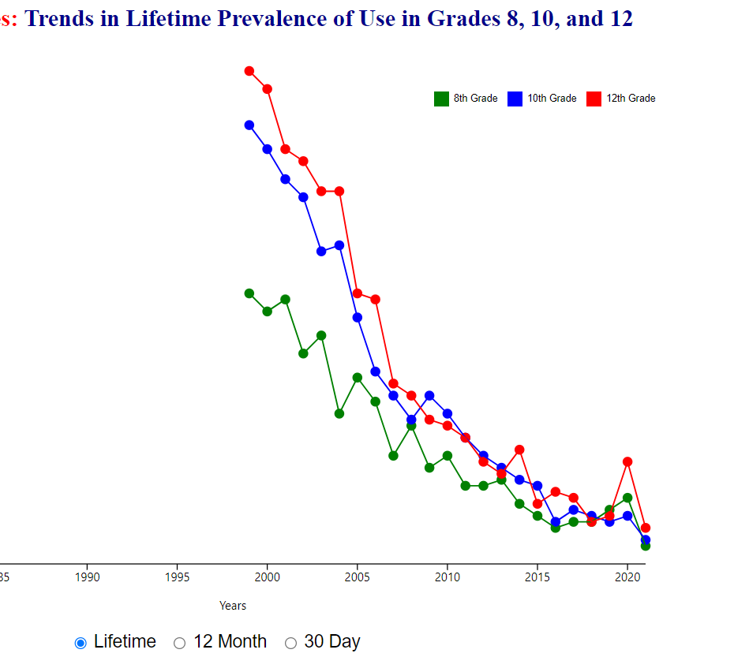
Something positive? Methamphetamines: Trends in 12 Month Prevalence of Use in Grades 8, 10, and 12
https://monitoringthefuture.org/data/Prevalence2021/Methamphetamines.htm

Slide 12
So what can we do to treat Stimulant Use Disorders?
The American Society of Addiction Medicine (ASAM)/American Academy of Addiction Psychiatry (AAAP) Clinical Practice Guidelines for the Management of Stimulant Use Disorder recommends CM as first line treatment
“CM has demonstrated the best effectiveness in the treatment of StUDs compared to any other intervention studied and represents the current standard of care.”
https://elearning.asam.org/stimulants-2 Free webinar series starting Feb 7th 2024
https://www.aaap.org/education/management-of-stimulant-use-disorder-guideline/

Slide 13
What is contingency management (CM)?
Contingency management (CM) is an evidence-based psychosocial intervention in which patients are given tangible rewards to reinforce positive behaviors related to treatment participation or outcomes; vouchers, prizes, and access to employment have been used successfully as incentives. (ASAM guidelines)
Notes:
Discuss use in HIV prevention

Slide 14
Effective Positive Reinforcement for CM
Well defined and achievable desired behavior
Attractive and tangible reward
Real-time presentation of incentive
Contingent (only given when desired behavior achieved)
Consistent

Slide 15
Well defined and achievable desired behavior
Negative UDS for methamphetamine
Can be positive for other substances particularly opioids
Do not rely on self-report

Slide 16
Achievable
stimulants out of UDS within 2-4 days, so rewards achievable early in treatment
Can test positive, not receive incentive, but return on next date with negative UDS and be eligible for incentive

Slide 17
Real-time presentation of incentive
Should be immediately provided incentive vs opportunity to draw for incentive (fishbowl method)
Should not depend on send out UDS (unless question re: positive testing)

Slide 18
Attractive and tangible reward
Non-cash payments that can exclude certain items (guns/ammo, alcohol)
Can be delivered in a “Fishbowl” method vs guaranteed reward
The Fishbowl Method (popularized by Dr. Nancy Petry) where clients who have earned an incentive draw a token from a “fishbowl” for a chance to win a prize of varying value
Voucher-Based Reinforcement Therapy (popularized by Dr. Stephen Higgins) where clients earn vouchers for completion of desired behaviors with the level of vouchers increasing according to an escalating schedule of reinforcement

Slide 19
Contingent
Reward is contingent upon defined behavior goal, in this case a negative UDS for methamphetamine
Do not reward when UDS is positive for methamphetamine

Slide 20
Consistent
Frequently measure behavior – typically 2 times a week on non-sequential days (no point if positive back-to-back days, given opportunity to return negative, and extend time in treatment if negative)

Slide 21
What is not CM?
Throwing a party for a group
Allowing all group attendees to receive gift card (unless goal is to attend group support, in which case this is a form of CM)
Providing food regardless of UDS results
Certificates of achievement

Slide 22
Evidence for CM and StimUD
CM is the most effective treatment to quit stimulant drugs (AshaRani et al., 2020: Bentzley, et al., 2021)
CM promotes abstinence post-treatment (Lussier et al., 2006; Prendergast et al., 2006).
Up to one year of benefit on drug abstinence post- CM, better than CBT (Ginley et al., 2021).
Research has observed larger effects when the CM protocol reinforces a target behavior immediately, at larger magnitudes, more frequently, and on escalating schedules (Griffith et al., 2000; Lussier et al., 2006; Roll et al., 1996).
CM can also be used to improve treatment attendance (Alessi et al., 2007; Petry et al., 2012b; Petry et al., 2018).
CM has higher retention rates than other StimUD treatments (Higgins et al., 1994)
CM is cost effective (Olmstead & Petry, 2009)

Slide 23
Contingency Management for Patients Receiving Medication for Opioid Use Disorder: A Systematic Review and Meta-analysis (Bolivar, et al., JAMA Psychiatry. 2021)
Findings In this systematic review and meta-analysis that included 74 randomized clinical trials and 10 444 adults receiving medication for opioid use disorder, the efficacy of contingency management was associated with abstinence from 4 types of substance use (psychomotor stimulants, polysubstance use, illicit opioids, and cigarettes) and improved treatment attendance and medication adherence.
Conclusions and Relevance These results provide evidence supporting the use of contingency management in addressing key clinical problems among patients receiving MOUD, including the ongoing epidemic of comorbid psychomotor stimulant misuse. Policies facilitating integration of contingency management into community MOUD services are sorely needed.

Slide 24
Why aren’t more community clinics doing CM?
Reason | Questions
Difficult to acknowledge failure rates Comfort with status quo | Why aren’t therapy and meds enough?
Stigma | Can we risk being in the news? Will there be a backlash?
Logistics of a POC utox | Procedure and Cost?
CM Technology apps difficult | Do we have the time? Can our pts access this?
Safety concerns | Does low tech CM create risk?
Cost | Where can CM funding come from?
Legal fears | Does CM violate kickback laws?
Notes:
Less than 10% of addiction treatment programs use CM per ASAM/AAAP guidelines

Slide 25
Acknowledgement of high SUD tx attrition rates
Academic MAT research doesn’t always mirror community experience
Adding CM as a treatment option doesn’t diminish importance of existing therapy and medical services
Desired outcome of CM can be continued participation in available services. Pts can’t benefit from integrated behavioral health services if they aren’t showing up.

Slide 26
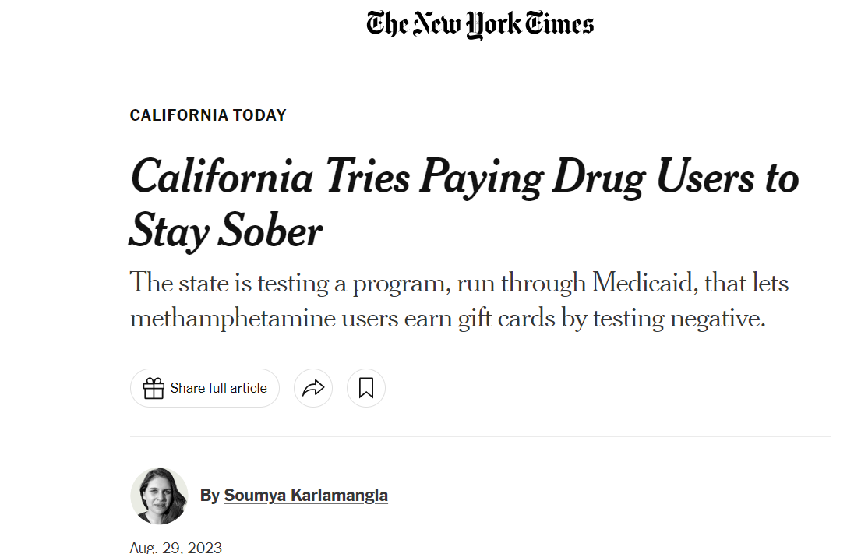
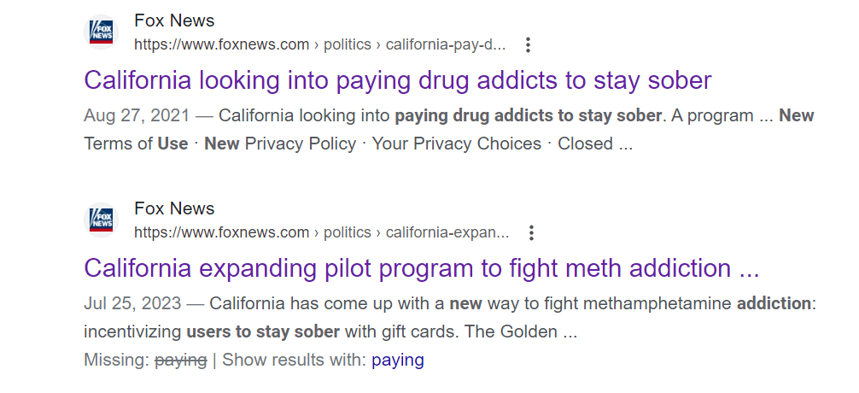
Stigma

Slide 27
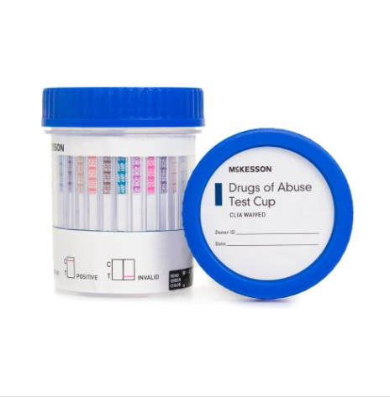
Logistics of Point of Care Urine Drug Screen
Procedure
Stress over result confrontations or cheating
Reimbursement
Challenge with POC fentanyl testing

Slide 28
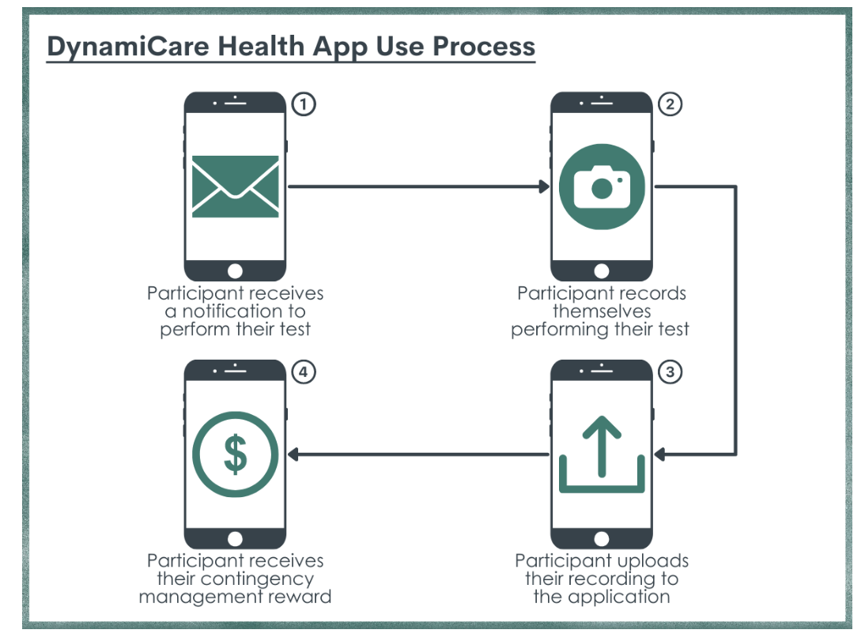
Technology Concerns
Much of CM body of research relies on App based and bank account based models.
Pts seeking treatment may be unhoused and
don’t have high data plans or bank accounts.
Feels time intensive to educate on apps.

Slide 29
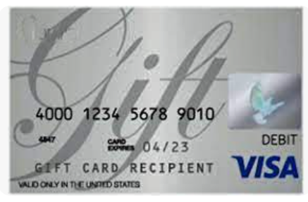
Low-Tech Safety worries
If clinic were to give cash cards or gift cards does that present a safety risk?
Does it present a bookkeeping risk or theft risk amongst staff?

Slide 30
Cost
Which bucket of money can this come from?
Many grant funds explicitly prohibit use of funds for direct patient incentives
Longstanding HHS guidelines established $75 value limit per beneficiary for incentives related to gifts of nominal value. Is that enough to do CM?

Slide 31
Legal Fears
What about anti-kickback laws?
We don’t want to be accused of paying pts to seek services so we can bill.

Slide 32
Vague Legalese
“HHS agencies established a $75 annual value limit for grant-funded CM incentives based on OIG guidance related to gifts of nominal value that are permissible under the Beneficiary Inducements CMP. This guidance includes a $75 annual, aggregate limit per beneficiary on the value of gifts (i.e., in-kind items or services, not cash payments), among other restrictions. Although this guidance does not directly pertain to CM incentives, OIG has noted that CM incentive arrangements may implicate the federal anti-kickback statute, the Beneficiary Inducements CMP, or both (101). However, CM incentives that implicate one or both of these statutes are not necessarily illegal; compliance depends on the specific facts of each arrangement, which must be analyzed on a case-by-case basis unless the arrangement satisfies an existing safe harbor or exception. Therefore, agencies have opted to retain the $75 annual value limit to prevent cases of non-compliance with the Beneficiary Inducements CMP.”

Slide 34
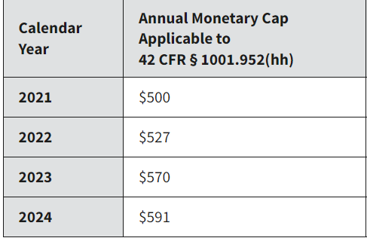
https://oig.hhs.gov/compliance/safe-harbor-regulations/annual-inflation-updates/

Slide 35
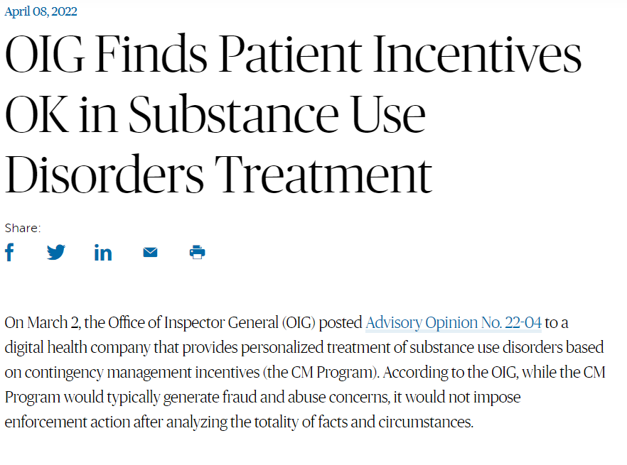
https://www.americanbar.org/groups/health_law/section-news/2022/april/oig-fin/

Slide 36
Some SAMHSA tips with CM
Don’t advertise incentives as part of treatment
Document need for CM in the treatment plan and the ICD10 Dx
Use research-based CM protocol
Carefully document that incentives are linked to client outcomes
Avoid tying CM visits with other Medicaid/Medicare billable encounter
Some of these rules may be modified; any adaptation should be done in careful consideration from state regulatory authority

Slide 37
How was Imperial Beach Community Clinic able to implement CM?
Executive leadership was open to the research behind CM and was interested in finding funding, even if not specifically grant-based
Recognition that developing an effective CM program for SUD could lead to future funding opportunities to support the clinic
Used low-tech, accessible model with Walmart gift cards of varying amounts
Full trust in employees to manage the gift card system
Integration of the CM reward for all health-related activities – therapy appointments, PCP appointments, addiction med appointments, psychiatry appointments, SMART recovery

Slide 38
IBCC Program
Started in 2018 with fishbowl method for all patients attending MAT appointments with providers, regardless of UDS results, as well as SMART recovery and individual therapy sessions
Targeted behavior: Increase Engagement
“Fishbowl” model: patient draws from bag for strip of paper either with a gift card amount or an inspirational quote. GC values from $5-$50 each.
Expanded in October 2022 to include treatment of Methamphetamine Use Disorder funded through SAMHSA grant limiting incentives to $75 total.
Targeted behavior: Negative UDS for MAP
Gift card given during every encounter with negative UDS for MAP.

Slide 39
For Methamphetamine Use Disorder
Patients meet with Behavioral health care manager or Peer Support Specialist for visits and receive a gift card for each methamphetamine-negative UDS provided on a weekly basis
Does not require an appointment with PCP or addiction med specialist
Low threshold to join program: Identified as having MAP Use Disorder and warm handoff to BH care manager or Peer Support Specialist to learn more and join program if expresses interest in cutting back/quitting use

Slide 40
Patient enrolled in CM programs
MAP: 44
OTP: 58
OTP and MAP 19

Slide 41
Cost of the program
Since December 2018 IBCC has spent a total of $30,710 on CM
Clinic funding: $6000
Grant Funding: $24,710

Slide 42
“Is it safe to keep incentives in your office?”
Gift cards are stored in secured boxes with limited access to care managers only.
Gift Card logs are used after every GC is issued
There have been no reported incidents of theft at IBCC

Slide 43
SMART recovery group at IBCC
IBCC has been facilitating SMART Recovery since 2018.
It’s open to the community – participants do not have to be IBCC patients
Occurs once per week from 6-7pm (evening hours have had higher attendance rates)
All BH clinicians, care managers, MSW students, and peer support specialists are trained SMART Facilitators and rotate every month.

Slide 44
Attendance at SMART recovery groups
In 2019 (pre-COVID) we had an average of 7-8 participants every meeting
During pandemic groups were held via telehealth with an average of 3-4 participants per meeting
In 2023 we had an average of 4-5 participants in every meeting.
Cohorts of participants throughout the years that support each other – this occurs organically. They hold each other accountable when they miss a meeting. They also celebrate each other’s wins.

Slide 45
Patient stories
“I didn’t know there was a treatment for meth, that is so cool!”
Gift Cards are used for:
For Immediate Needs: eggs, milk, personal hygiene, etc.
To treat themselves
In SMART Recovery Group, participants often give their GCs to others with more immediate needs.

Slide 46
Patient Story
The patient is a 40-year-old Caucasian female who has been receiving care at IBCC since 2018. Upon initial presentation, she was homeless and struggling with severe MAP use. Following a screening by a care manager, she was referred to psychiatry and therapy, both of which she actively participates in. She has successfully maintained sobriety from MAP for approximately 4 years. The patient has found benefit in individual counseling and psychiatry. Recognizing the risk of relapse due to an unstable housing situation, she was enrolled in our CM program and has continued to stay sober, expressing gratitude each time she receives a GC. Currently residing with her son, she actively participates in weekly addiction support meetings within the community.

Slide 47
Future focus
Getting the word out
What amount is effective?
HHS funded programs still limit to $75 per patient
“Using an incentive value that is too low does not represent evidence-based practices and is unlikely to be effective; such implementations may lead decision-makers to erroneously conclude that CM is not effective.” ASAM/AAAP guidelines

Slide 48
www.dhcs.ca.gov/CalAIM/Documents/CM-Fact-Sheet.pdf

Slide 49
Recovery Incentives Program
https://www.dhcs.ca.gov/Pages/DMC-ODS-Contingency-Management.aspx

Slide 50
Recovery Incentives Program Escalating incentives

Slide 51
https://aspe.hhs.gov/sites/default/files/documents/72bda5309911c29cd1ba3202c9ee0e03/contingency-management-sub-treatment.pdf

Slide 52
Hope for federal support Excerpt from Executive Summary
“There are many opportunities for entities overseeing CM implementation -- including, among others, regulators at the federal, state, Tribal, local, and territorial levels -- to overcome barriers to CM access, strengthen the quality of CM services, and promote program integrity. Key opportunities include ensuring the implementation of and fidelity to evidence-based treatment protocols, clarifying the application of certain federal fraud and abuse laws to CM incentives, disseminating best practices on CM implementation, raising incentive limits in federal grant programs to enable evidence-based CM delivery…”
“Ultimately, there is immense need to expand the implementation of CM, as it has tremendous potential to address the nation’s high rate of overdose deaths and, in particular, the increasing rate of stimulant-involved overdose deaths.”

