Slide 1
Transition Clinic Networks /
Medi-Cal Transformation Justice-Involved Initiative
COUNTY OF SAN DIEGO
HEALTH AND HUMAN SERVICES AGENCY
Sayone Thihalolipavan, MD, MPH, Justice-Involved Health Officer, Medical Care Services

Slide 2
Transitions Clinic Network
In 2021, County of San Diego Board of Supervisors directed a series of actions now known as the County’s Alternatives to Incarceration (ATI) initiative.
The County contracted with San Diego Association of Governments (SANDAG) to conduct data analysis, gather community and stakeholder input and formulate recommendations for the ATI Work Plan.
Both SANDAG’s recommendations and the ATI Work Plan include piloting Transitions Clinics, utilizing the evidenced-based Transitions Clinic Network model.

Slide 3
Transitions Clinic
Transition Clinics provide a patient-centered primary care medical home. Each program is based within safety-net community health centers in neighborhoods most impacted by incarceration, and provides:
Community Health Workers with a history of incarceration as part of an integrated medical team
Linkages with correctional partners to provide continuity of care
Easy access to comprehensive primary care
Culturally competent, patient-centered medical services
Close partnerships with local reentry and social services organizations to address social drivers of health.
Will serve individuals with health needs being released from a County jail.
Close partnership with Sheriff Department.

Slide 4
San Diego County
Medi-Cal currently provides health insurance coverage for over 1,000,000 people in San Diego County.
Almost 1 out of 3 people in San Diego County are Medi-Cal beneficiaries.
San Diego is the fifth largest County in the United States and has the second largest Medi-Cal population in California.
37,142 adults reentered the community from San Diego County jails in 2022.
If enrolled in Medi-Cal, most adults from state prisons and county jails and all youth/young adults from youth detention facilities returning to the community are eligible for services through CalAIM in San Diego County starting in 2024.
Notes:
Opportunity to scale up services

Slide 5
Medi-Cal Transformation Overview
Puts people’s needs at the center of care
Provides coordinated support to address health and social needs
Uses a population health approach
Addresses equity to support equal access to health and well-being
Works to align funding, data reporting, quality, and infrastructure

Slide 6
Medi-Cal Transformation Components
Key Components
Enhanced Care Management
Community Supports
Population Health Management
Behavioral Health Initiative
Dental Initiative
Integrated Care for Dual Eligible Members
Statewide Managed Long-Term Care
Supporting Health and Opportunity for Children and Families
Justice-Involved (JI) Initiative

Slide 7
Background on Medi-Cal Transformation JI Initiative
On January 26, 2023, California became the first state in the nation to receive federal approval to offer a targeted set of Medicaid services to Medi-Cal eligible youth and adults in state prisons, county jails, and youth correctional facilities for up to 90 days prior to release.
Key components of Medi-Cal Transformation, Justice-Involved Initiative are ensuring individuals have active Medi-Cal upon release, access to pre-release services, and post-release care coordination.

Slide 8
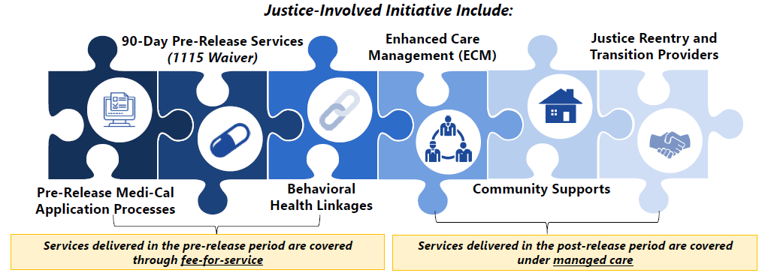
Medi-Cal Transformation Justice-Involved (JI) Initiative

Slide 9
Medi-Cal Transformation JI Initiative Timeline
Pre-Release Medi-Cal Enrollment
ECM for the JI Population
Behavioral Health Linkages
90-Day Pre-Release Services
January 1, 2023
January 1, 2024
October 1, 2024
October 1, 2024-Sept 30, 2026
March 31, 2024
PATH JI Round 3 Implementation Plans Due

Slide 10
Ehanced Care Management (ECM)
Enhanced Care Management, which is commonly referred to as ‘ECM’ is a free service to eligible Medi-Cal members.
ECM services include:
An assigned Lead Care Manager
Help finding a doctor
Help arranging transportation to appointments
Assistance applying for food benefits and locating food resources
Assistance connecting to social support programs, including Community Supports

Slide 11
JI ECM Eligibility Criteria
Adults Transitioning from Incarceration
Medi-Cal eligible and meets at least one of the following criteria:
Mental Illness
Substance Use Disorder
Chronic Conditions
Intellectual or Developmental Disability
Traumatic Brain Injury
HIV/AIDS
Pregnant or Postpartum
Youth/Young Adults Transitioning from Incarceration from a youth facility
Medi-Cal eligible and no further eligibility criteria

Slide 12
ECM Referral Form
ECM Referrals can be made emailing a referral form to a member’s Medi-Cal health plan.
Medi-Cal Health Plans | Referral Form | Email/Fax
Blue Shield Promise | ECM Referral Form (blueshieldca.com) | Email: ECM@blueshieldca.com
Community Health Group | ECM Referral Form (chgsd.com) | Email: ecm-cs@chgsd.com
Kaiser | ECM Referral Form (kaiserpermanente.org) | Email: RegCareCoordCaseMgmt@KP.org
Molina | ECM Referral Form (molinahealthcare.com) | Email: MHC_ECM@Molinahealthcare.com

Slide 13
SANDIEGOCOUNTY.GOV/HHSA

Slide 14
THANK YOU
SANDIEGOCOUNTY.GOV/HHSA

