Slide 1
The San Diego Access and Crisis Line (ACL)

Slide 2
Our Mission:
To help people live healthier lives and help make the health system work better for everyone.

Slide 3
The Access and Crisis Line (ACL)
We have operated the ACL on behalf of the County of San Diego since 1997
We assist San Diego residents of all ages
We are a 24 hours a day 7 days a week
Confidential & free of charge
Suicide prevention, crisis prevention and behavioral health referrals
988 Lifeline Crisis Center; supporting national suicide prevention lines:​
988
1-800-273-TALK
800-SUICIDE

Slide 4
Who are our staff?
Our clinicians are mental health professionals who have a Master’s Degree or possess an active license: PhD, PsyD, LMFT, LCSW, LPCC, RN
We are a team with varied professional work history and lived experiences: private practice, clinic, inpatient, ER, crisis residential, substance use treatment and more….
Approximately 30% of our clinicians are bilingual speaking Spanish.
We use Language Line to assist with translation in up to 200 languages.
CA Relay (711) to assist those with hearing difficulties

Slide 5
What Does the ACL Do?
Crisis Intervention
Suicide Prevention, Intervention, & Postvention
Behavioral Health referrals
ACL
Mobile Crisis Response Team Screening
We help people live healthier lives through…
Follow Up
Afterhours Authorizations for Medi-Cal Beneficiaries

Slide 6
We provide….
Clinical screenings in order to meet individuals' unique behavioral health needs
Brief, solution focused crisis intervention, suicide prevention, intervention, and postvention
“No wrong door” This policy ensures that Medi-Cal beneficiaries receive timely mental health services without delay regardless of the delivery system where they seek care.
Collaboration in connecting with beneficiaries Medi-Cal managed care health plans (MCPs).

Slide 7
What our callers can expect
Each contact to the ACL captures the following seven key elements:
Connect with the individual and expressing empathy
Identify their behavioral health need
Completion of a clinical screening for appropriate level of care and degree of urgency
Screen for risk factors: SI/HI, mental health, substance use, etc.
Provide apt clinical interventions
Disseminate suitable referrals to meet their unique needs
Accurate documentation

Slide 8
Person Centered: Recovery Community Partners
Access and Crisis Line
Community Clinics
Person Served
Peer Support, Clubhouses, Counseling
Supportive Housing
Family, Friends, Spirituality
Organizational Providers
Case Management
Substance Use Disorder Services
Hospitals and Crisis Houses
Hospitals and Crisis Houses

Slide 9
How do we do it?
Telephone
Local:
888-724-7240
CA Relay: 711
National:
988
800-273-Talk
800-Suicide
Chat:
optumsandiego.com
up2sd.org
Chat is available:
Monday-Friday
4 PM – 10 PM

Slide 10
Why Chat?
Accessibility
Proximity to Others
Extra Layer of Anonymity
Shyness or Anxiety
Hearing or Speech Issues

Slide 11
Chat access is located here: Home (optumsandiego.com)

Slide 12
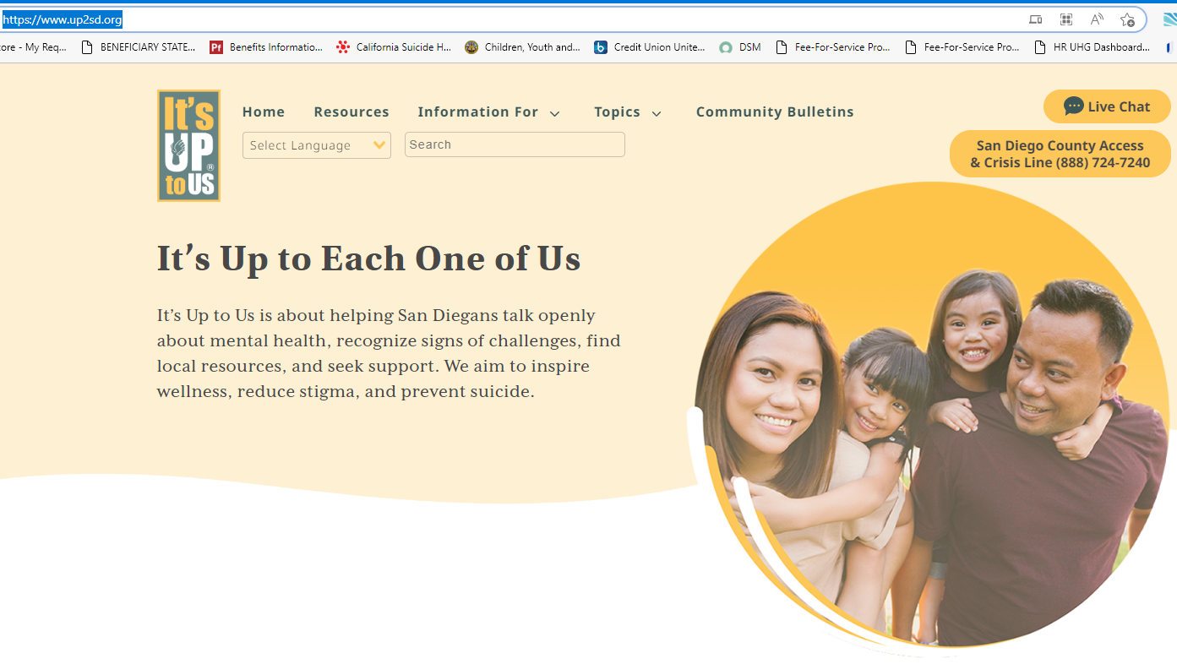
Chat access is also located here: San Diego Health and Human Services | It's Up to Us (up2sd.org)

Slide 13
Q&A

Slide 14
It was a pleasure meeting with you.

