Slide 1
San Diego County MCRT Services
Mobile Crisis Response Team

Slide 2
What is Mobile Crisis Response Team (MCRT)?
MCRT brings rapid crisis support to people experiencing mental health or substance use crises.
This model delivers safe, accessible, compassionate support to residents of all ages in San Diego County.
Our goal is to help people get the support they need by stabilizing and linking them to behavioral health services as needed.
Notes:
Telecare MCRT is serving 5 of the six regions of San Diego county and Exodus is serving the North Coastal Region
.

Slide 3
MCRT Covers All Regions in San Diego
Since 2021 MCRT has served the 6 Regions of San Diego County:
North Costal, North Inland, North Central, Central, East & South

Slide 4
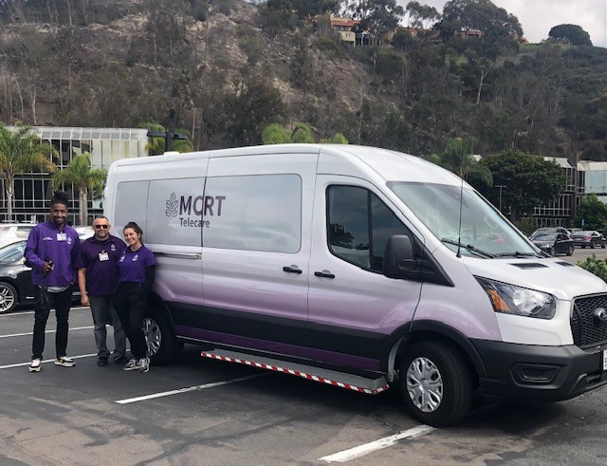
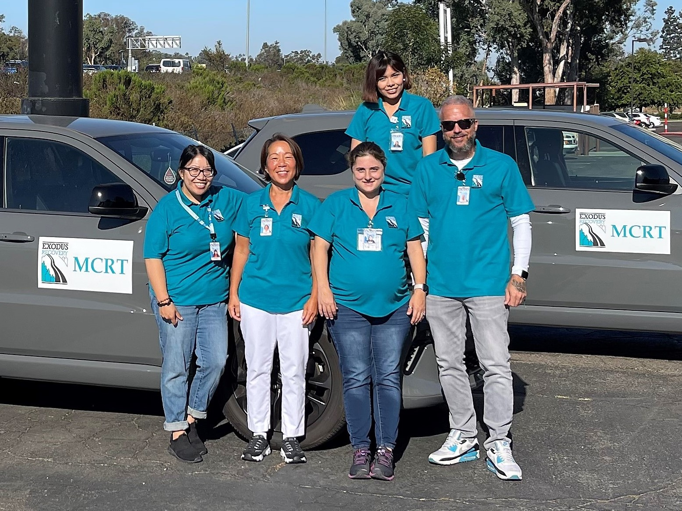
Our Staff
Each mobile team includes:
A Licensed Clinician
A Masters level Case Manager
A Peer Support Specialist
Call Center Triage Team staffed with:
Masters Level Clinicians

Slide 5
MCRT Deployment & Response Overview

Slide 6
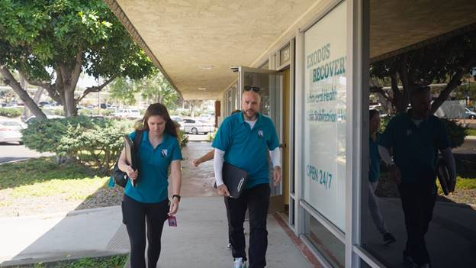
Services and Supports
Services include crisis triage, screening, assessment, crisis intervention and stabilization, Safety Planning & Care Coordination.
Services are 24/7.
Mobile crisis teams provide on-site support in vehicles equipped with a host of resources & safety features for 5150s.
If needed, MCRT can be transported to behavioral health services for further treatment.
Care Coordination may be provided for up to 30-days to assist with connection to ongoing behavioral health services.

Slide 7
MCRT Referral Criteria
No weapons
No Injuries /Medical Emergency
No threat of immediate violence to self or others
The person is not involved in serious criminal activity
Person is not known to be wanted in connection with an ongoing criminal investigation
Law enforcement was not specifically requested

Slide 8
When to Call MCRT
Call if a person is having a behavioral health crisis and they are not immediately trying to harm themself or others during the incident. For example:
Threatening suicide but no immediate risk to harm self
Severely depressed (i.e., hopeless, sad, not eating, not getting out of bed)
Verbally threatening or “posturing” but not violent (i.e., loud, yelling, responding to voices, pacing, anxious, etc.).
Threatening to run away
Could become a danger to themself or others
If not sure what to do, call ACL to consult
Notes:
No BH issue
Transport ONLY
Watching Children
Calls for those unhoused but have no behavioral health crisis

Slide 9
MCRT Services are Inclusive & Trauma Informed
MCRT is aware that trauma is common in displaced populations and those experiencing crisis.
People can & do recover from trauma with the help and support from community, church & peer groups.
MCRT services are designed to best support healing & recovery through:
Integration of the individual’s voice
Familiarity with relevant cultural resources
With permission, the inclusion of family, religious affiliations, & social supports
Being welcoming & linguistically inclusive
Sharing power & decision-making

Slide 10
Benefits of Mobile Crisis Service
In some cases, MCRT is changing the individual's entry point into the system of care, increasing access to treatment that might otherwise be unknown to some.
MCRT is helping to avoid unnecessary incarcerations in lieu of treatment.
Currently everyone is eligible, services are not limited by age, location, or insurance.
MCRT is providing behavioral health care to the most vulnerable populations reducing strain to emergency rooms and the behavioral health system overall.
MCRT is reducing stigma associated with behavioral health crisis.

Slide 11
Some of Our Partners & Care Coordination
This program partners closely with:
Culturally Relevant & Holistic Resources & Providers
San Diego Behavioral Health Services
Access and Crisis Line (ACL)
All Law Enforcement Agencies
Crisis Stabilization Units (CSUs)
Walk-in Assessment Centers (WIAC)
Many other Stakeholders

Slide 12
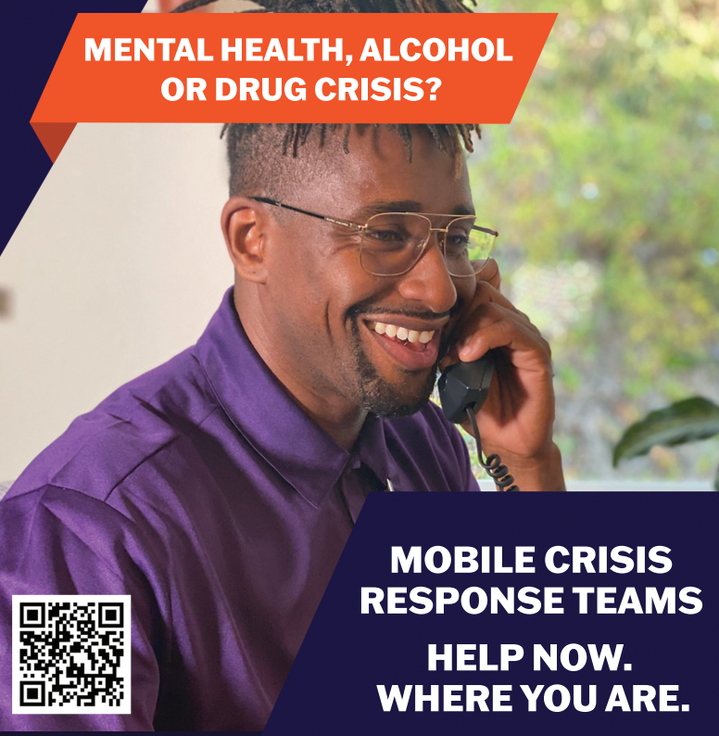
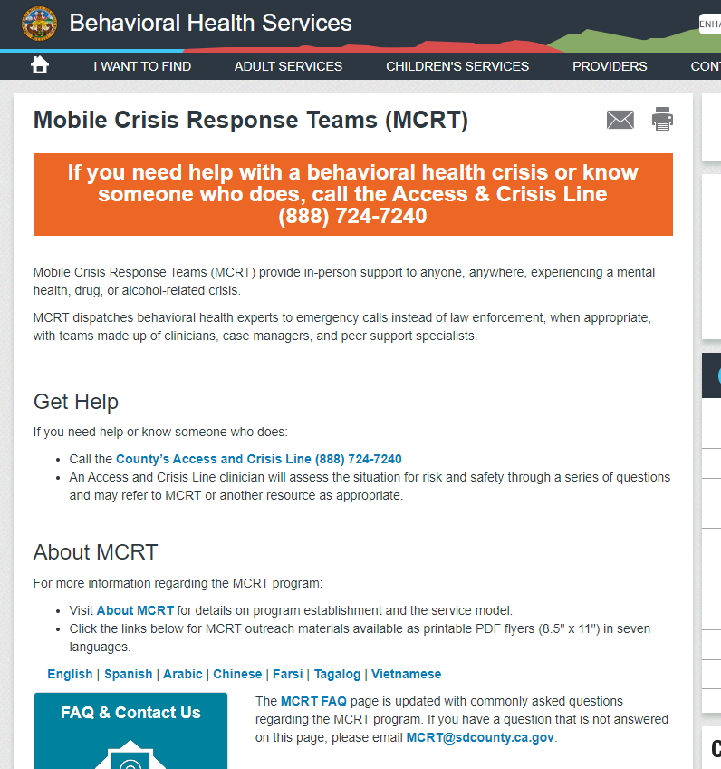
San Diego Behavioral Health Service MCRT Website
Please visit the San Diego County Behavioral Heath Service website to learn more about MCRT. There you will find:
Frequently Asked Questions
Downloadable MCRT Posters in different threshold languages
Enter the following link into your web browser:
www.sandiegocounty.gov/mcrt/

Slide 13
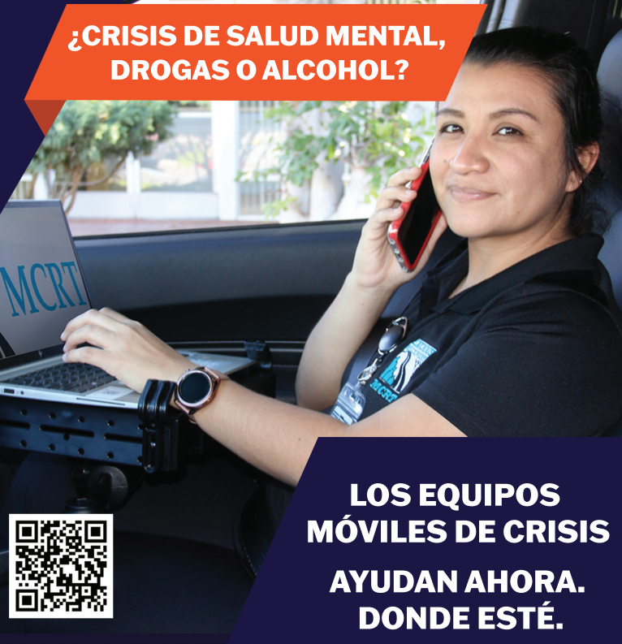
How to Make a MCRT Referral & MCRT Access Points
To access services with MCRT, contact San Diego County’s Access and Crisis Line (ACL):
(888) 724-7240.
MCRT clinicians are available 24 hours, 7 days per week.
MCRT is fully integrated with Law Enforcement.

Slide 14
For Questions Contact
Breawna Lane, LMFT
Telecare Administrator |North Central, Central, North Inland, East & South Regions
blane@telecarecorp.com
Mary Woods, LMFT, MAC
Telecare Regional Director of Operations
mwoods@telecarecorp.com
Megan Patrick Thompson, Ph.D
Exodus Program Director | North Coastal Region
mpthompson@exodusrecovery.com
Alisha Eftekhari, LMFT
Assistant Medical Services Administrator |County of San Diego, Behavioral Health Services
Alisha.Eftekhari@sdcounty.ca.gov

Slide 15
Questions?

