Slide 1
Housing, Homelessness, and Mental Health
Eric Rafla-Yuan, MD
Chief Financial Officer, Social Determinants of Health Network
Contributing Journal Editor, Psychiatric Services
Chair, APA Caucus on the Social Determinants of Mental Health
988 Equity and Accessibility Working Group Chair, CalOES

Slide 2
Disclosures
Relevant Financial Disclosures: none
Name of Ineligible Company | Nature of Relevant Financial Relationship
None | N/A
An ineligible company is any entity whose primary business is producing, marketing, selling, re-selling, or distributing healthcare products used by or on patients.

Slide 3
Public Perceptions of Homelessness and Mental Health

Slide 4
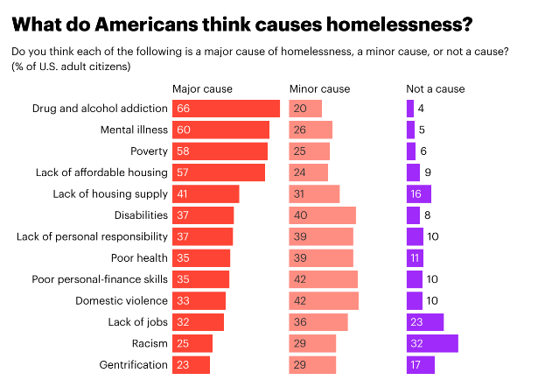
What Causes Homelessness?
In a 2022 survey of 1,000 adults in the US
Drug and alcohol addiction (66%)
Mental illness (60%)
Poverty (58%)
Lack of affordable housing (57%)
Americans are most likely to say the following are not causes of homelessness:
Racism (32% say it is not a cause of homelessness)
Lack of jobs (23% say not a cause)
Gentrification (17% say not a cause)
Lack of housing supply (16% say not a cause)

Slide 5
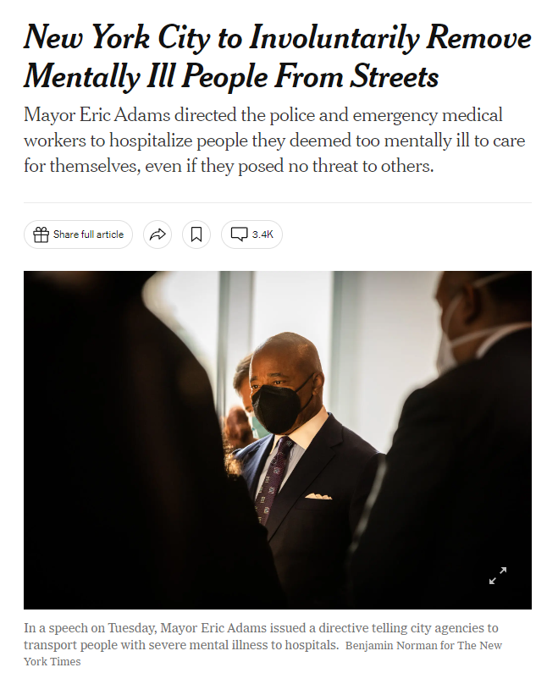

Slide 7
Perceptions Matter
Policy Response
Public Response
Political Action
Media Response
Policy Response
Media Response
Public Response
Political Response
Executive Action
Legislation
Funding
Programs
Education and Training

Slide 8
Public response, Political response, Policy response
A small number of individuals with severe mental illness capture much of the media coverage and public response
Policies designed for people with the most publicity

Slide 9
What does the evidence say?

Slide 10
Homelessness is primarily driven by two factors
Homelessness
Housing Unaffordability
Housing Unavailability

Slide 11
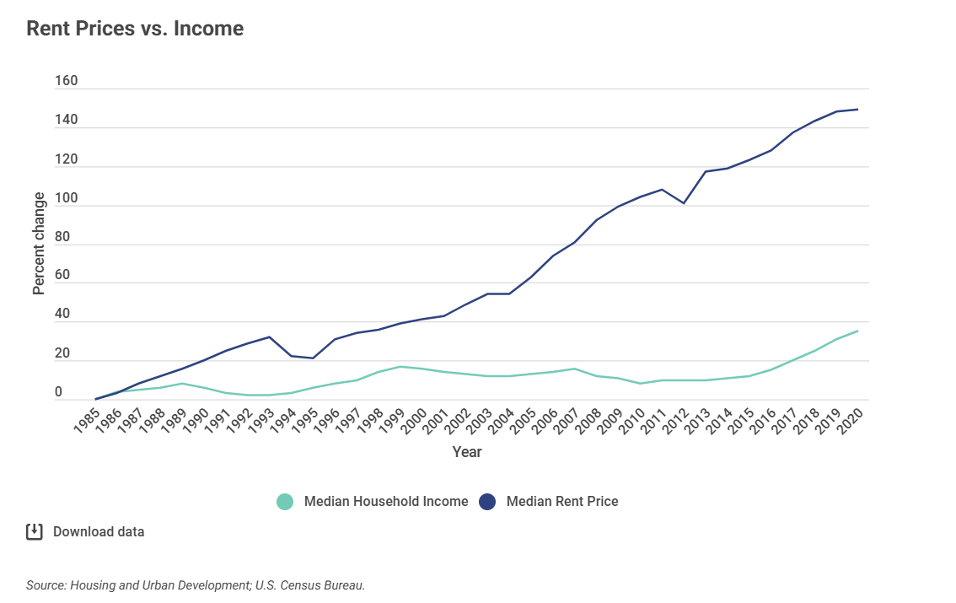
Housing Unaffordability
From 1985 to 2020, rent price increases have exceeded income increases by 325%

Slide 13
Source: California Legislative Analysist’s Office (2015)

Slide 14
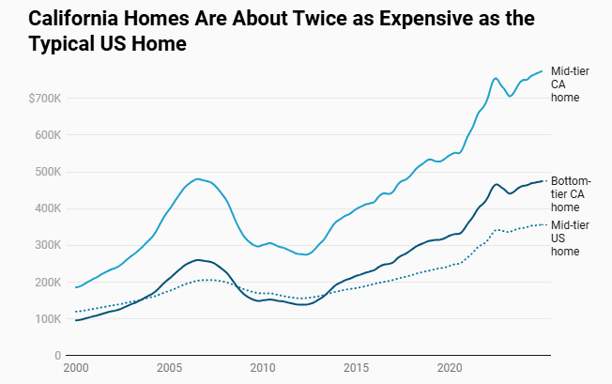
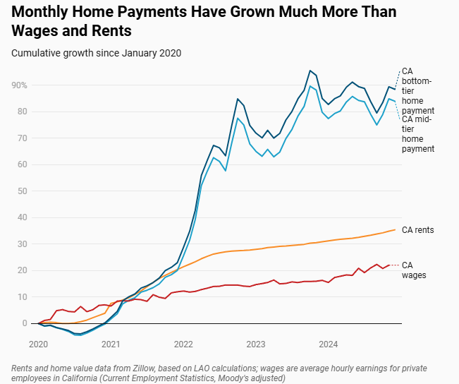
Source: California Legislative Analysist’s Office (2025)

Slide 15
Housing Unaffordability

Slide 16
Housing Unaffordability

Slide 17
Housing Unavailability

Slide 18
Housing Unavailability

Slide 19
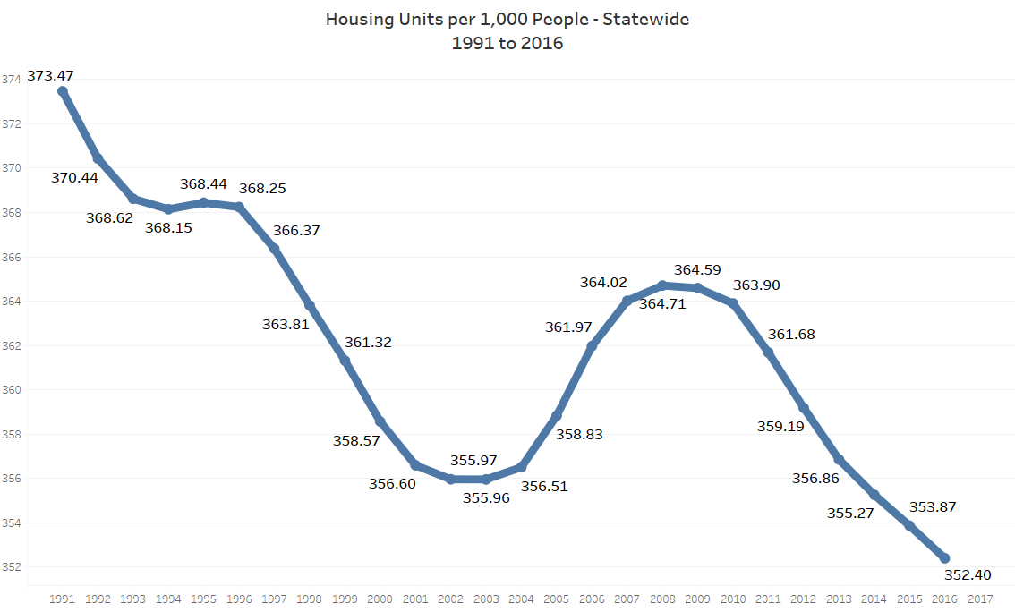
Housing Unavailability (CA edition)
Source: California State Association of Counties

Slide 20
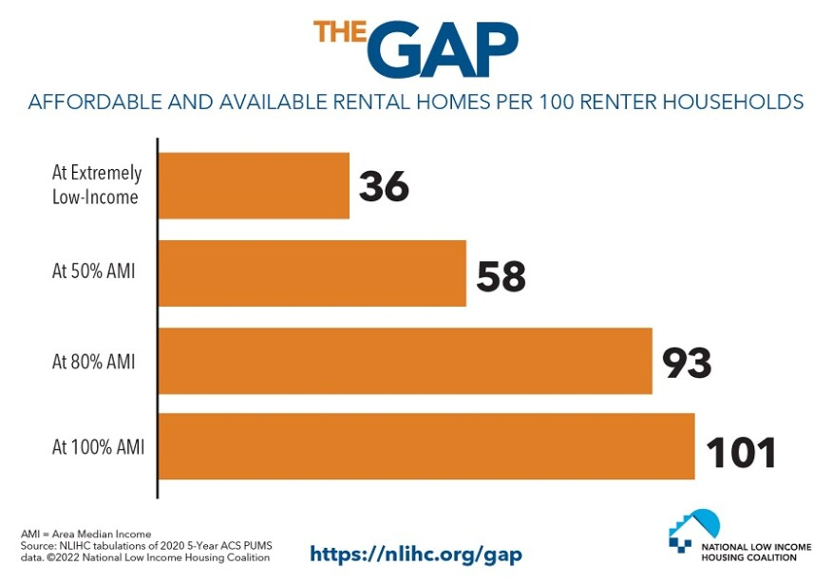
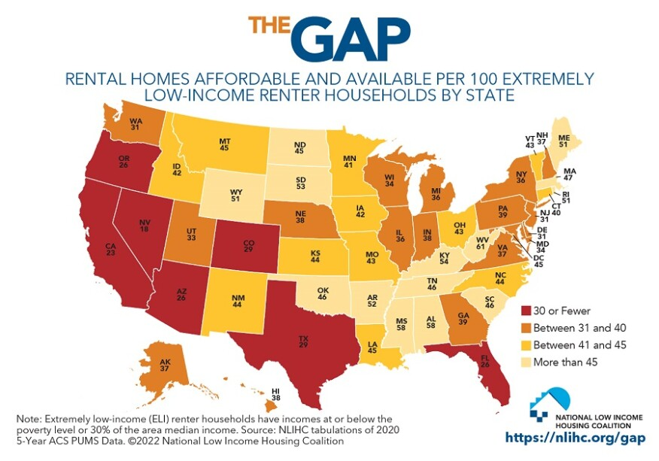
Affordable Housing?

Slide 21
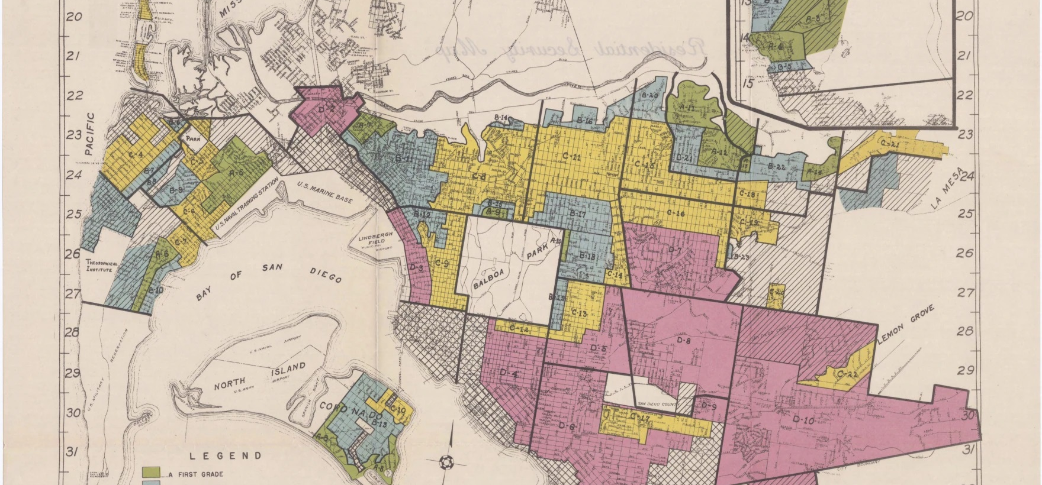
Structural Racism, Housing Inequity, and Homelessness

Slide 23
Redlining
The discriminatory practice of denying financial services to neighborhoods based on race, ethnicity, or poverty
Can also refer to the practice of withholding public and private funding or city services from certain neighborhoods.

Slide 25
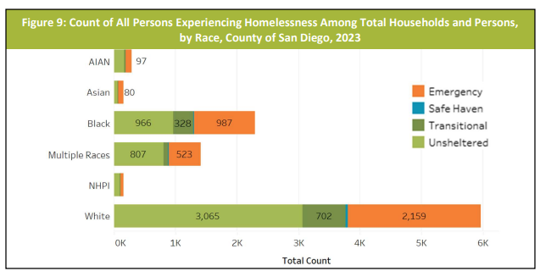
San Diego County (2023)
Black individuals accounted for 22% of the total PEH population despite being only 4.8% of the County overall population.

Slide 26
Structural Racism, Housing Inequities, and Homelessness

Slide 27
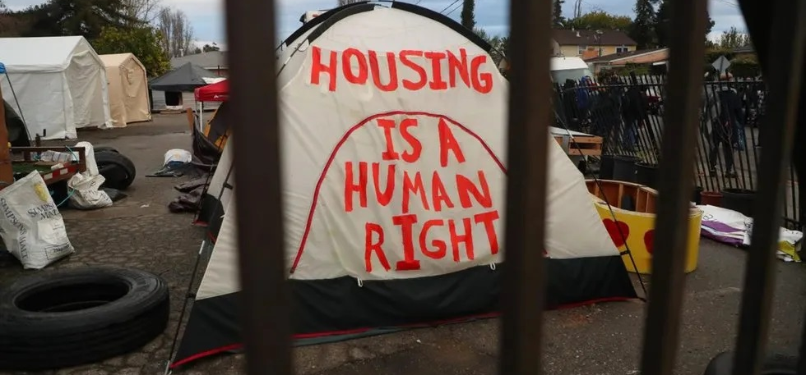
The Relationship between Homelessness and Mental Illness

Slide 28
The Relationship between Homelessness and Mental Illness
Homelessness and psychiatric disorders are distinct
Interrelated factors contribute to both
Prior military service
Lack of social support or connection
Experiencing interpersonal violence
History of incarceration
Poor physical health
Facing repeated discrimination or interpersonal racism

Slide 29
Homelessness vs Mental illness
Misconception: All homeless individuals have severe mental illness
Reality: Homeless individuals with severe mental illness are more likely to be chronically and visibly homeless

Slide 30
Criminalization of Homelessness and Mental Illness
Homelessness
Mental Illness*

Slide 31
Criminalization of Homelessness and Mental Illness
Homelessness
Mental Illness*
Criminalization

Slide 32
Criminalization of Homelessness and Mental Illness
Homelessness and/or Mental Illness
Criminal history and possible incarceration
Legal barriers for both housing and employment post-incarceration
Low-level, nonviolent misdemeanors (sleeping in public, panhandling, loitering)

Slide 33
Evidence-Based Interventions for Homeless Individuals with Severe Mental Illness

Slide 34
Evidence-Based Interventions for Homeless Individuals with SMI
Assertive Community Treatment (ACT)
Critical Time Intervention (CTI)
Intensive Case Management (ICM)
Permanent Supportive Housing (PSH)
Supported Employment Programs (SEP)
Street Medicine*

Slide 35
Assertive Community Treatment (ACT)
Intensive, clinically based approach that involves a multidisciplinary team providing treatment, rehabilitation, and support services for individuals with severe mental illness (SMI)
Generally longer term, designed to flexibly respond to medical and social needs, even when emergent.

Slide 36
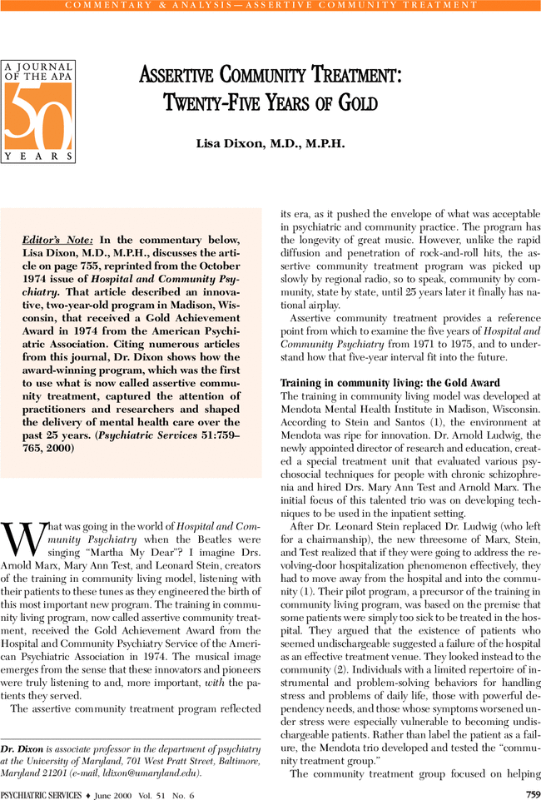
Assertive Community Treatment (ACT)
Demonstrates significant reductions in homelessness, hospitalizations, and psychiatric symptoms, even compared to standard case management services
Not more costly than standard care
Higher satisfaction ratings for clients and families

Slide 37
Critical Time Intervention (CTI)
Targeted, time-limited, high-intensity case management support for individuals transitioning from an institutional setting (eg, shelters, hospitals, jails, prisons, foster care) to a community setting.
Can increase service engagement while reducing homelessness and emergency service utilization.

Slide 39
Intensive Case Management (ICM)
Addresses housing needs and other social needs through frequent nonclinical support and referrals to clinical services
Case managers interact with clients multiple days a week
Improves housing stability, reduces the number of days spent homeless, and improves quality of life
Despite its nonclinical nature, intensive case management can also improve many general medical and mental health outcomes

Slide 40
Permanent Supportive Housing (PSH)
Prioritizes housing with integrated treatment and social services without requiring prior treatment or abstinence
Can improve long-term housing outcomes for individuals with SMI
Supported by numerous studies across multiple countries, including in direct comparison to housing programs that require treatment first

Slide 41
Permanent Supportive Housing
Real data on what has and hasn't worked in CA on homelessness
Some key points drawn from state data between 2018-2021 are:
Between 2018 and 2021, the state spent $9.6 billion trying to “move the needle on homelessness”
Of that spending, it turns out that the initiative most likely to lead people out of homelessness was permanent supportive housing
Of the more than 75,000 people placed into permanent supportive housing of some kind, only 8% wound up back on the street within six months (the primary endpoint tracked)
Said another way, permanent supportive housing had a 92% success rate of keeping people housed

Slide 42
Supported Employment Programs (SEP)
Focuses on placing and maintaining individuals with SMI in jobs that match their capabilities and preferences
Increases employment and improves participation in housing programs among populations with SMI
Reduces emergency department utilization, likelihood of incarceration, and probability of returning to homelessness once housed.

Slide 43
Street Medicine*
Provides healthcare and social support directly to people experiencing homelessness by meeting them where they are, often on the street
Utilizes a harm-reduction and team-based approach to address immediate mental health and substance use disorder (SUD) needs
Often integrated with broader medical care, referrals, case management, and provision of basic necessities such as food, water, clothing, and hygiene items
Over 150 street medicine programs currently operate in the U.S., with CMS now reimbursing street psychiatry services
Preliminary findings suggest cost savings by reducing emergency room and hospital visits
Reaches individuals with serious mental illness (SMI) who might not otherwise receive care
*Additional large-scale research is needed to refine effectiveness, essential components, and best practices

Slide 44
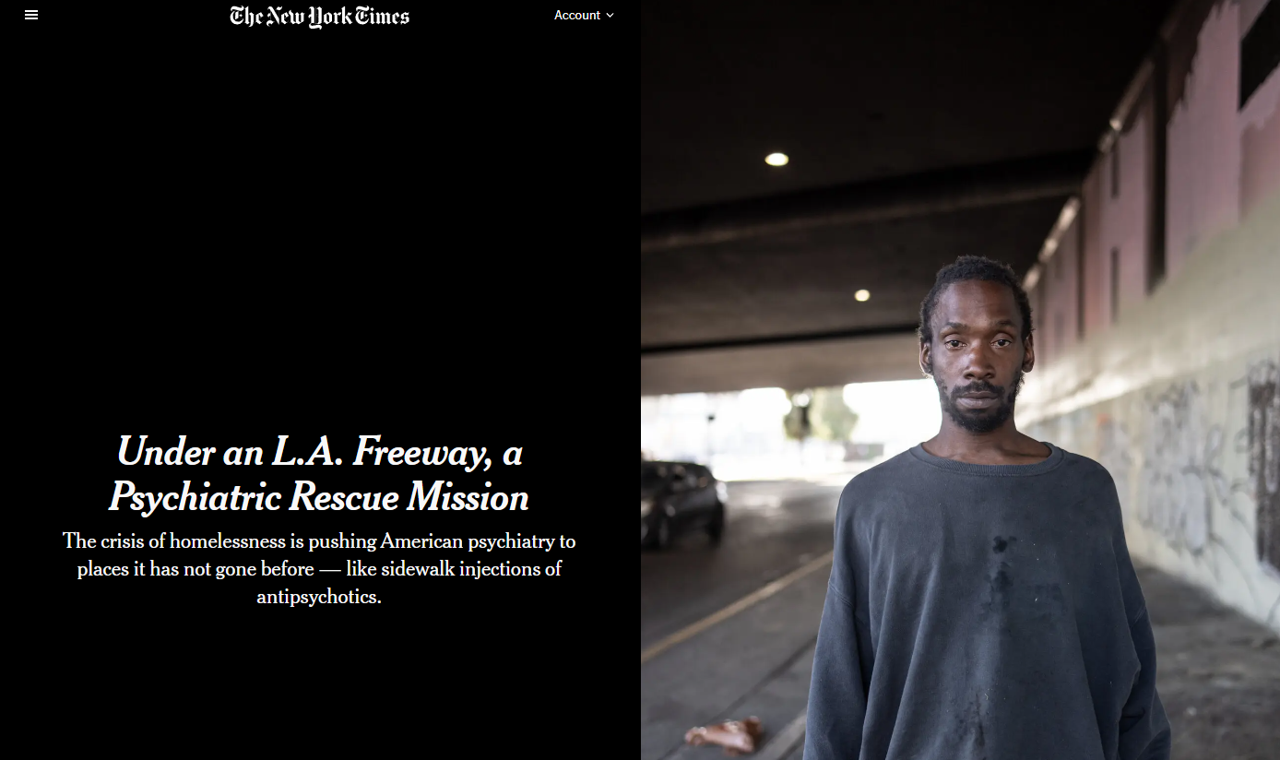
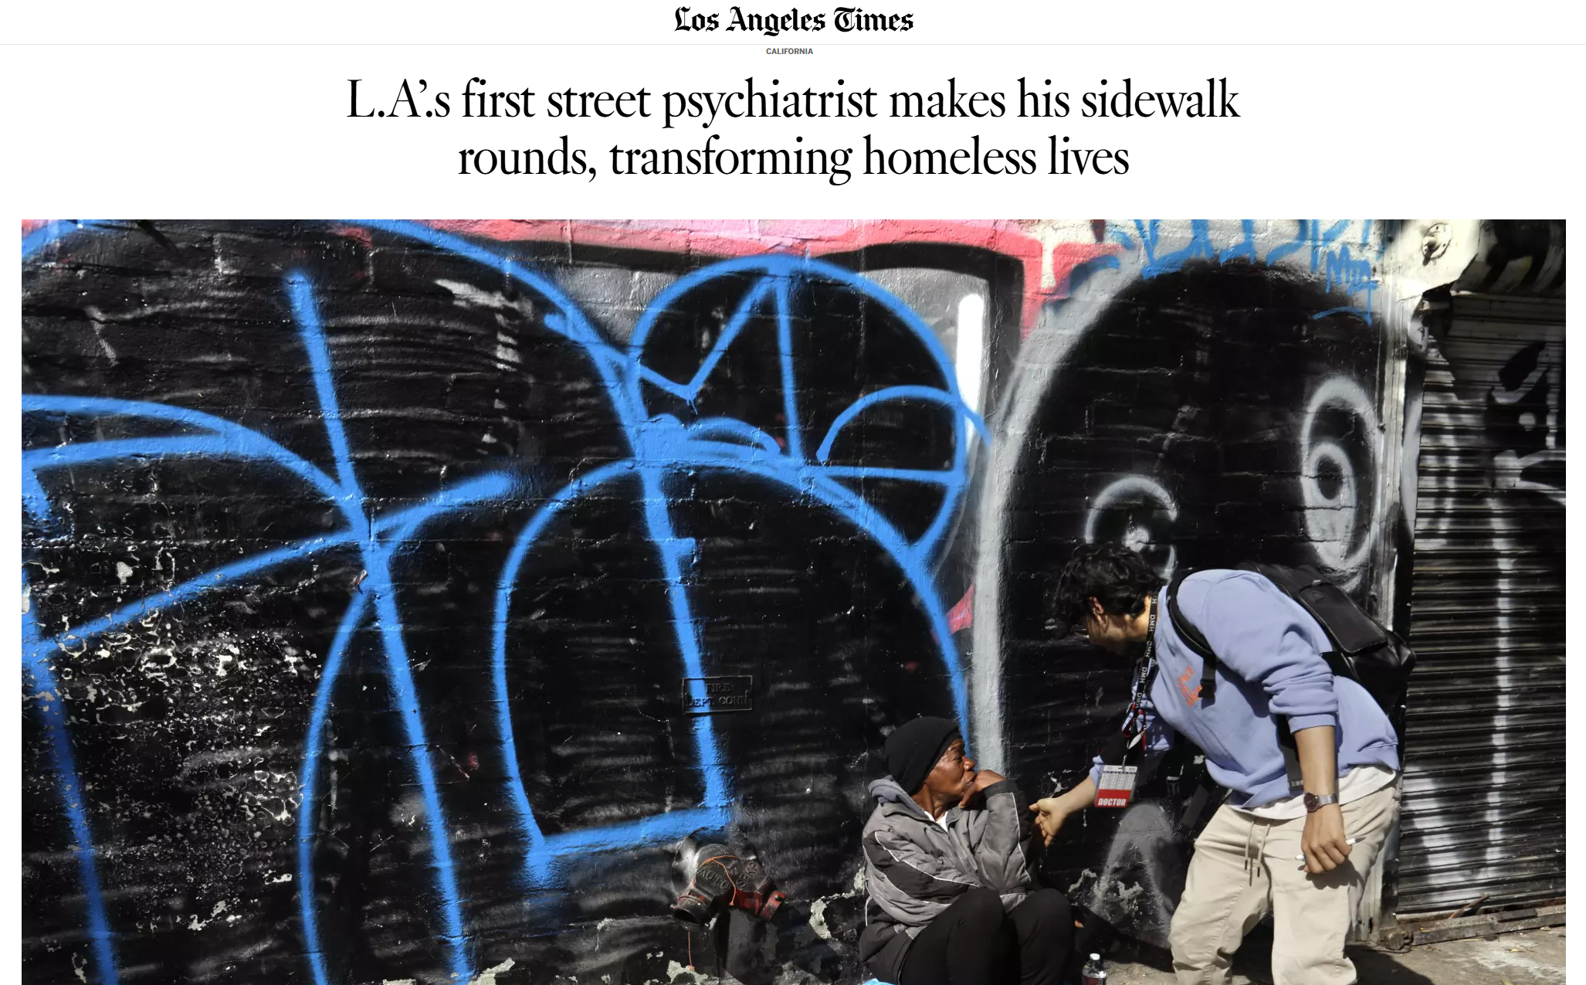
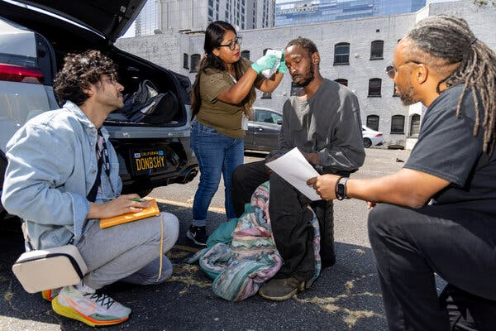
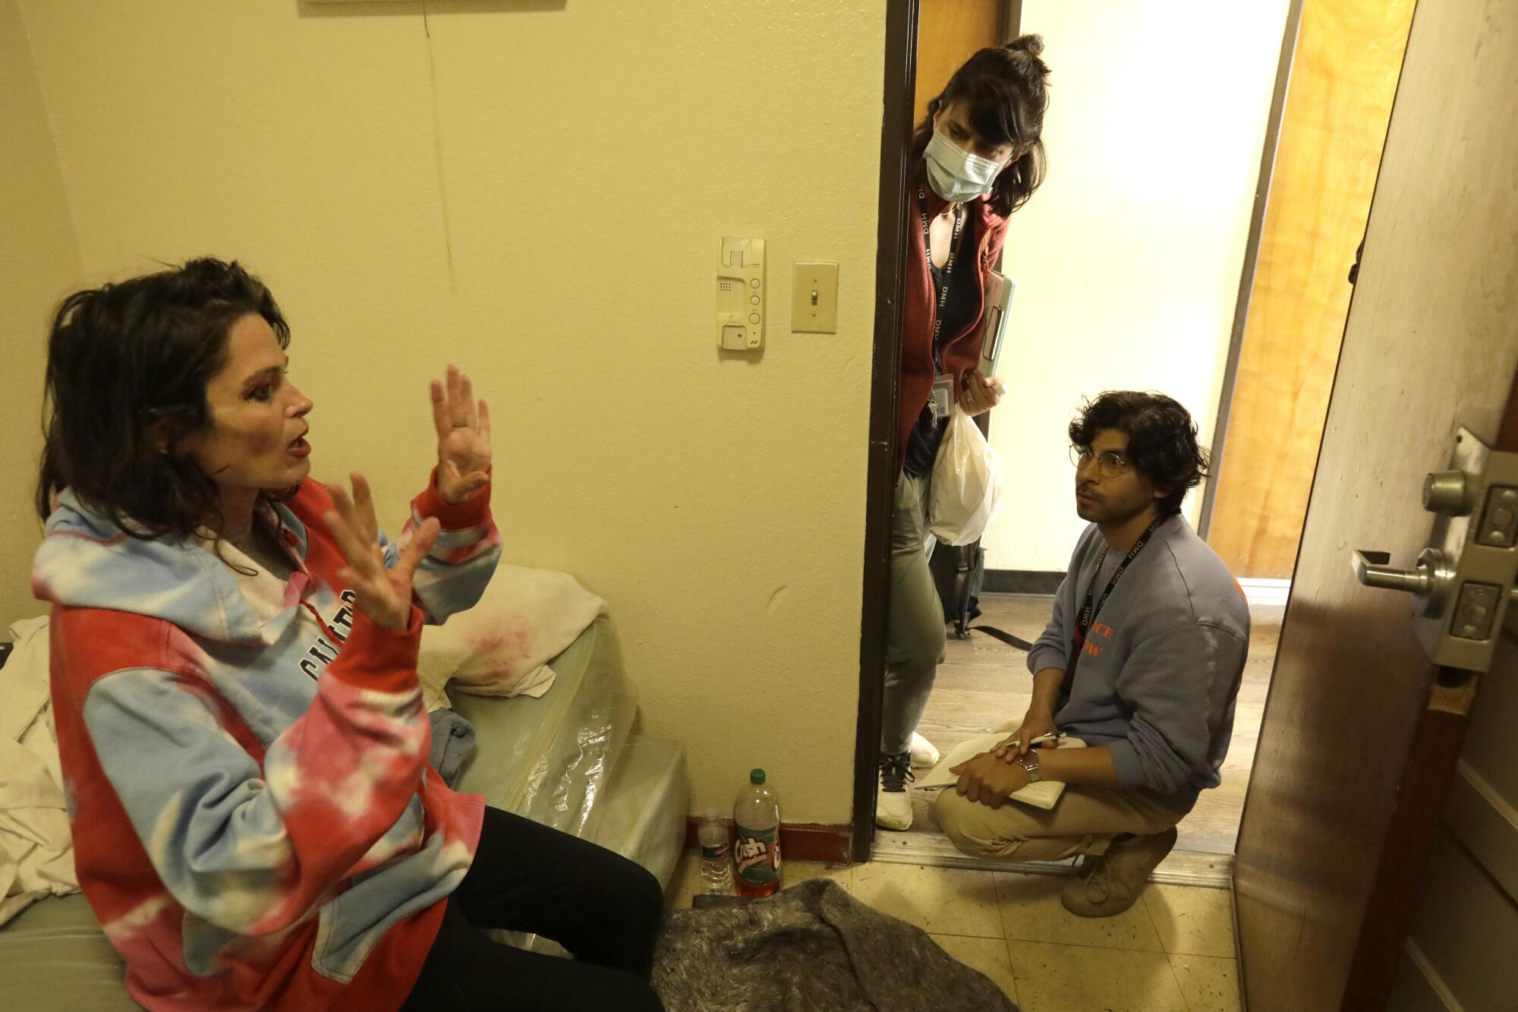
Street Medicine*

Slide 45
Some exciting updates!
California Behavioral Health Community-Based Organized Networks of Equitable Care and Treatment (BH-CONNECT) Demonstration
Assertive Community Treatment (ACT)
Forensic ACT (FACT) Services
Individual Placement and Support (IPS) Supported Employment
Enhanced Community Health Worker (CHW) Services
Clubhouse Services

Slide 46
BH-CONNECT Timeline
Implementation will occur in phases:
Starting July 1, 2025: Counties may opt to offer services like
Assertive Community Treatment (ACT)
Forensic ACT (FACT)
Coordinated Specialty Care for First Episode Psychosis
Individual Placement and Support (IPS) Supported Employment
Community Health Worker Services
Clubhouse Services.
Starting July 1, 2025:, Medi-Cal Managed Care Plans (MCPs) may choose to provide up to six months of transitional rent assistance to qualified individuals. By January 1, 2026, offering this service will become mandatory for all MCPs for persons with significant behavioral health needs and mandatory for other populations in later phases.

Slide 47
Conclusions
Housing is a critical social determinant of health, directly impacting mental health outcomes
Homelessness is driven by systemic factors such as housing unaffordability, unavailability, and structural racism
Mental illness and homelessness are interrelated but distinct
Criminalization worsens homelessness and creates barriers to recovery, employment, and stable housing
Evidence-based interventions do exist and work
Sustainable funding and policy changes are essential to scaling effective solutions.

Slide 48
Conclusions
Individuals with severe mental illness are the canaries in the coal mine for the systemic issue of homelessness

Slide 49
Scientific Journal Citations
Aubry, Tim, et al. "Effectiveness of permanent supportive housing and income assistance interventions for homeless individuals in high-income countries: a systematic review." The Lancet Public Health 5.6 (2020): e342-e360.
Brown, Rebecca T., et al. "Factors associated with mortality among homeless older adults in California: the HOPE HOME study." JAMA Internal Medicine 182.10 (2022): 1052-1060.
Dixon, Lisa. "Assertive community treatment: twenty-five years of gold." Psychiatric Services 51.6 (2000): 759-765.
Giano, Zachary, et al. "Forty years of research on predictors of homelessness." Community Mental Health Journal 56.4 (2020): 692-709.
Kirkbride, James B., et al. "The social determinants of mental health and disorder: evidence, prevention and recommendations." World psychiatry 23.1 (2024): 58.
London, Jack. "Homeless mentally ill or mentally ill homeless." American Journal of Psychiatry 149.6 (1992): 816-823.
Nilsson, Sandra Feodor, Merete Nordentoft, and Carsten Hjorthøj. "Individual-level predictors for becoming homeless and exiting homelessness: a systematic review and meta-analysis." Journal of urban health 96.5 (2019): 741-750.
Rafla-Yuan, Eric, et al. "Housing, homelessness, and mental health." Psychiatric Annals 54.7 (2024): e202-e208.

Slide 50
Reference Reports
Statewide homelessness assessment ( July 1, 2018 – June 30, 2021). California Interagency Council on Homelessness. https://bcsh.ca.gov/calich/documents/homelessness_assessment.pdf
California Housing Affordability Tracker, California Legislative Analyst's Office https://lao.ca.gov/LAOEconTax/Article/Detail/793
Persons Experiencing Homelessness in San Diego County (2022-2023), County of San Diego, Health and Human Services Agency, Public Health Services, Community Health Statistics Unit https://www.sandiegocounty.gov/content/dam/sdc/hhsa/programs/phs/CHS/Persons%20Experiencing%20Homelessness%20in%20SDC_8.12.24.pdf
The Gap: A Shortage of Affordable Homes. National Low Income Housing Coalition, March 2024. https://nlihc.org/gap
Mapping Inequality: Redlining in New Deal America. Edited by Robert K. Nelson and Edward L. Ayers, American Panorama: An Atlas of United States History, 2023 https://dsl.richmond.edu/panorama/redlining

